Slide 1
Challenging sustainability through different techniques

Slide 2
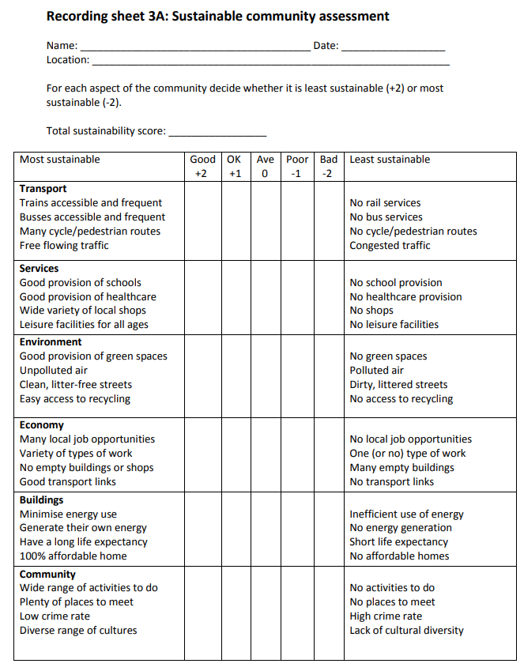
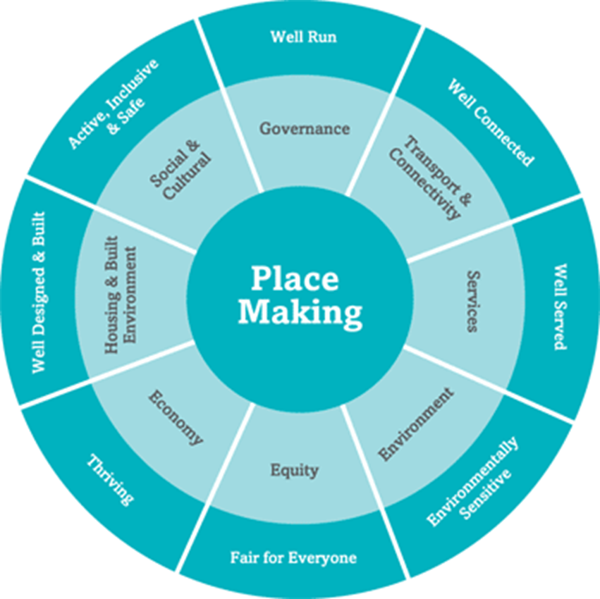
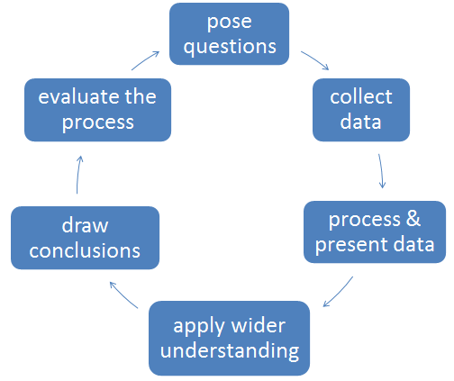
Sustainable living
Sustainable Community Environmental Quality Survey
A Sustainable Community Assessment could be developed using elements from Egan’s Wheel.
Source: (Fieldwork through Enquiry, GA publication)
Notes:
Similar to EQS

Slide 3
Questionnaires
Who knows an area best?
Obviously it is the people who live, work and spend their lives there.
http://www.placecheck.info/
Notes:
Questionnaires: could collect data about different aspects of sustainable living from different stakeholder groups e.g. views on community cohesion and involvement, inclusiveness, building design, safety, perception of crime / traffic / travel options pollution etc.;

Slide 4
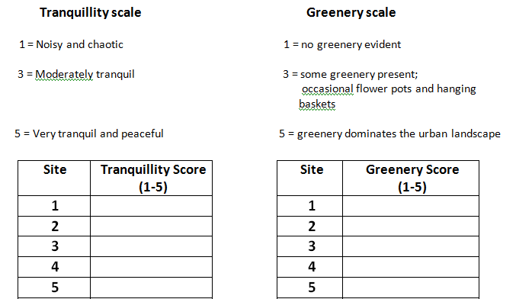
Street Tranquillity and Greenery

Slide 5
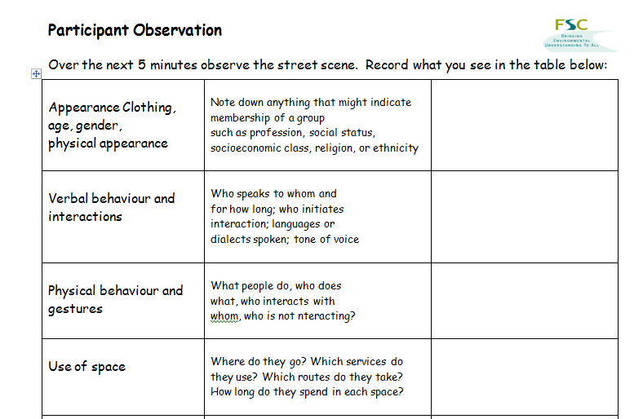
Participant Survey
Notes:
Results from the observations could be compared to Egan’s Wheel.

Slide 6
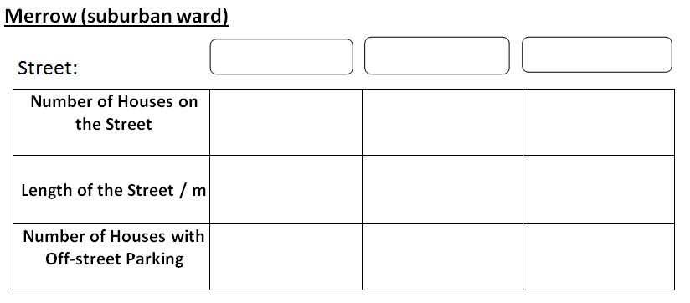
Housing density and off street parking

Slide 7
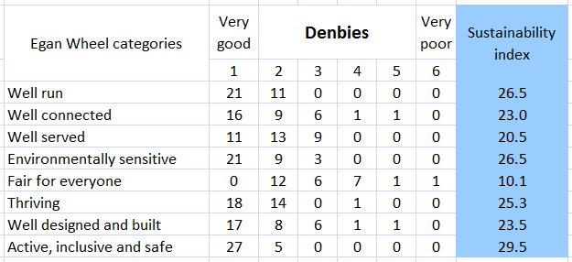
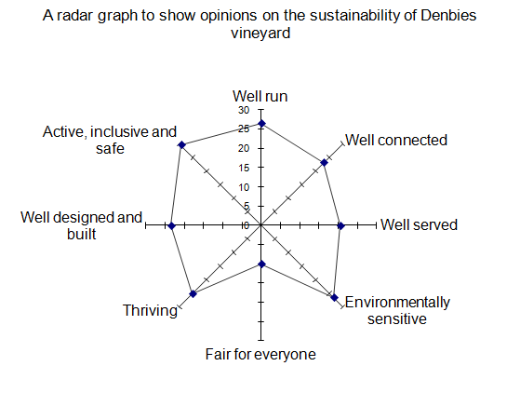
Surveys: Indices or bi-polar scores to collect data about how key components (e.g. of the Egan Wheel) can be applied to an area (or areas). Students could record evidence such as noise levels, traffic flow, travel options, quality of pavements/green spaces/ cycle routes, building design (as examples). They might combine such surveys with taking photos to illustrate the best and the worst examples of sustainable living;

Slide 8
Other suggestions for using Egan’s Wheel might include primary or secondary sources:
Traffic counts
Access to public transport
Access to services
Questionnaires to gauge the views of local people
Environmental Quality Surveys
Sensory fieldwork
Photographs/sketches of buildings – identifying sustainable features

