Slide 1
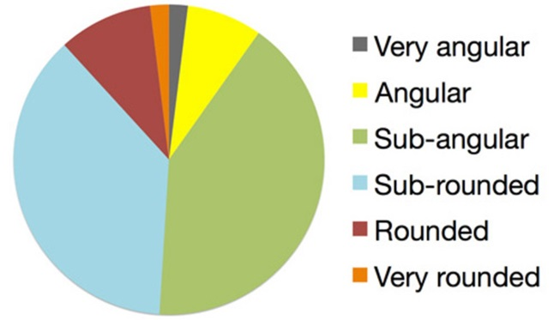
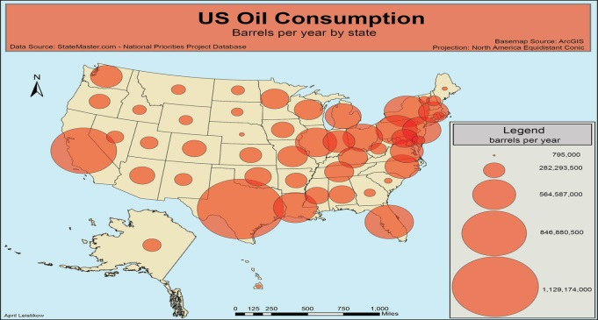
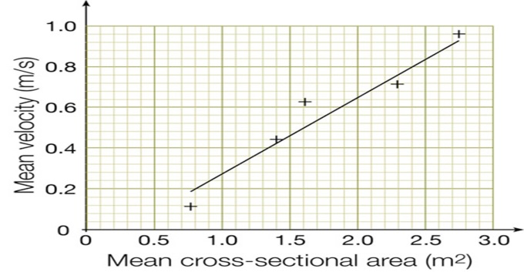
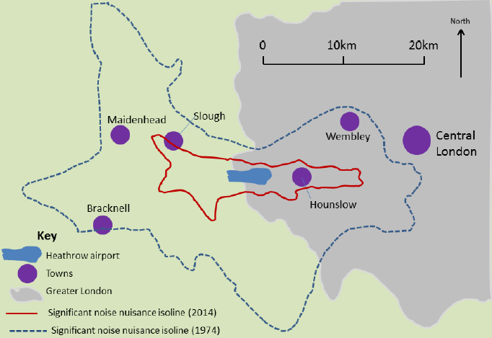
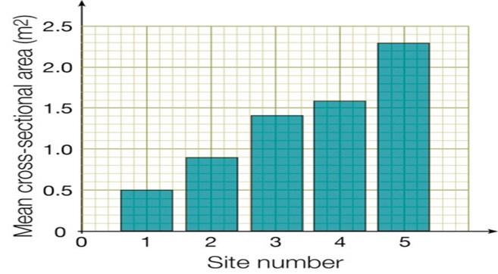
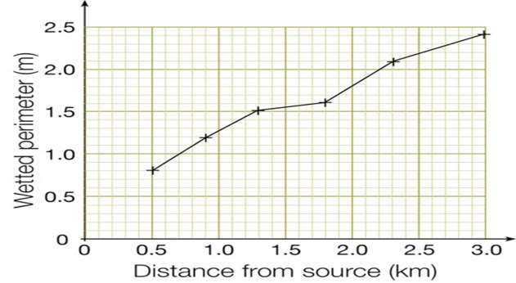
Pie Charts Used to represent percentages. Easy to draw. Easy to understand and interpret. Calculating the size of each section can be more difficult than a bar chart. Lots of segments can make it difficult to analyse |  | Proportional symbols map Used to show located data. Good visual representation of data. Sophisticated technique. Needs a correct scale otherwise it can be difficult to read. If there isn’t a scale it is difficult to calculate an actual value.
Scatter graphs Used to compare 2 sets of data. Easy to construct. Shows the correlation between data. Needs a large data set. Almost impossible to label data points. |  | Isoline Map Used to areas of equal values. Good visual representation of data. Easy to show patterns/trends. Can be difficult to construct. Small lines and numbers can be difficult to read.
Bar Graphs Used to show absolute values. Easy to construct. Easy to understand. Should only be used with discrete data. Can be too simplistic. |  | Triangular Graphs Used to show the relationship between 3 pieces of data. 3 pieces of data can be compared at once.. Easy to compare data. Data must be in percentages. Can be difficult to read and construct.
Line Graph Used to show continuous data. Easy to construct and understand. Anomalies are easy to identify. Can be time consuming to construct. Often require additional information to be useful. |  | Choropleth Maps Used to show values for different locations Visually effective. Easy to see patterns. Time consuming to construct. Doesn’t show variations within one area.

