Slide 1
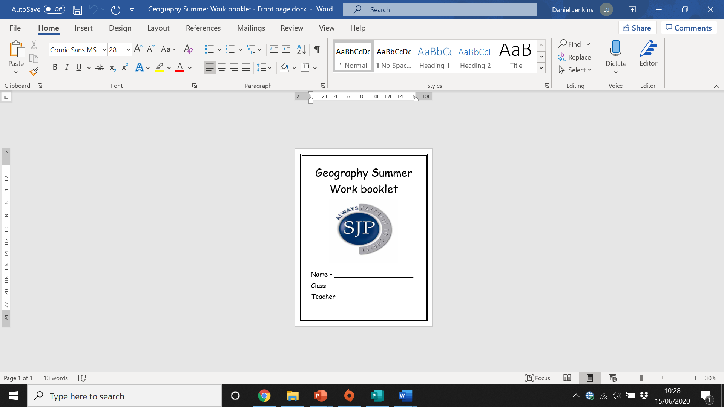

Slide 2
Checking My Knowledge
Read each statement carefully and consider if you think you are red, amber or green in that area.
Red = I think I have no knowledge in this area
Amber = I think I have some knowledge in this area
Green = I am confident in my knowledge in this area
Knowledge and Skills | R | A | G
Section 1: Map skills
I can name and locate the world’s seven continents and five oceans.
I can use world maps, atlases and globes to identify the United Kingdom and its countries.
I can use the eight points of a compass, four and six-figure grid references and identify symbols on maps.
I can understand contour lines and identify height above sea level on a map.
I can identify countries in each continent on a map
Section 2: The water cycle
I know what a drainage basin is and the features within it.
I can label a diagram of the water cycle.
I can identify the caused of flooding.
I can identify the effects of flooding and categorise in to Social economic and environmental effects.
Section 3: Food and farming
I can identify the three types of farming.
I can explain the difference between organic and non-organic farming.
I can explain how people farm in developing countries.
I understand why it is difficult to grow food in countries based on their location.
I can define food availability and food security.
I can Analyse choropleth maps and give reasons for the trends they show.
Section 4: China
I can describe the population distribution of China.
I can define rural urban migration and identify push and pull factors.
I can explain the positive and negative impacts of the one child policy.
I can define sustainability and suggest methods China can improve their carbon footprint.
Section 5: Tectonics
I can accurately label a diagram of the structure of the earth.
I can identify where earthquakes and volcanoes take place around the world.
I can explain how earthquakes are formed.
I can analyse the social, economic and environmental impacts of tectonic events.

Slide 3
Command words.
Throughout geography, we come across a variety of command words. It is important that we learn as many as we can, so we are able to quickly know what a question or task is asking of us.
These are here to help you, please refer back to them while completing work in this booklet.
Command Word | Meaning
account for | explain (reason)
analyse | examine closely; examine in parts; show how the parts contribute to the whole
assess | decide the value of; judge; measure the importance of
compare | discuss two or more things in terms of their similarities and differences
critically evaluate | weigh arguments for and against something; assess all evidence; decide which opinions, theories, models or items are preferable.
describe | give a detailed account of the features of something without interpreting the information
discuss | present and give a judgement on the value of arguments for and against; consider all angles
evaluate | judge; criticise in terms of impact/significance, and investigate the implications
examine | make clear the details/meaning of; look in particular at reasons, causes and effects; account for; give reasons; justify
explore | describe in detail and note impact
indicate | focus on specific areas (similar to illustrate)
interpret | make clear the meaning of; consider implications
outline | describe main features; give a broad but thorough account; identify briefly the main features of
relate | show similarities and connections between two or more things
review | describe chief features and criticise generally (important parts)

Slide 4
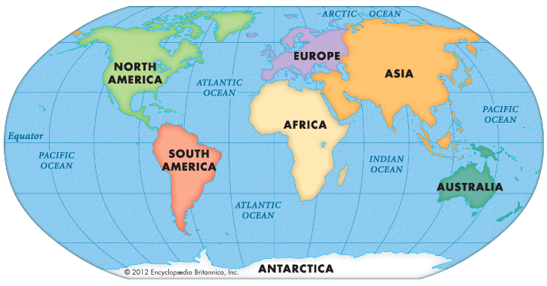
Section 1 – Map Skills
Mapping Our World
From space, the Earth looks like a sphere, or ball, containing land and water. A globe is a model of the Earth and shows what it looks like from space. Some globes show how the land is divided into different countries - around 200 of them. All the countries on our planet are in seven different continents:
Europe
Africa
North America
South America
Asia
Australia
Antarctica
Maps and atlases
Maps are useful tools to help people find their way to and from somewhere. They are much easier to carry than a globe and much more detail can be added to them.
Maps can show the whole world, a single country or even a single town or village. Maps of different countries can be put together in a book called an atlas or they can be on a single sheet of paper. These can be useful to carry when you go walking so you do not get lost.

Slide 5
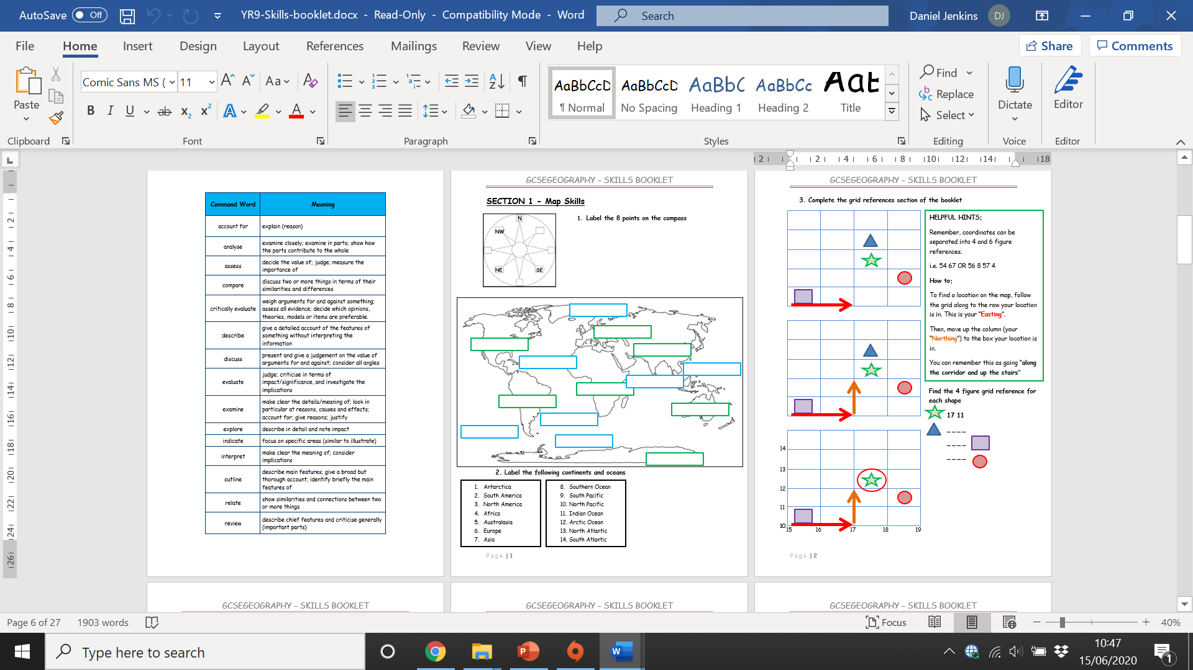
Mapping Our World: Practise time!

Slide 6
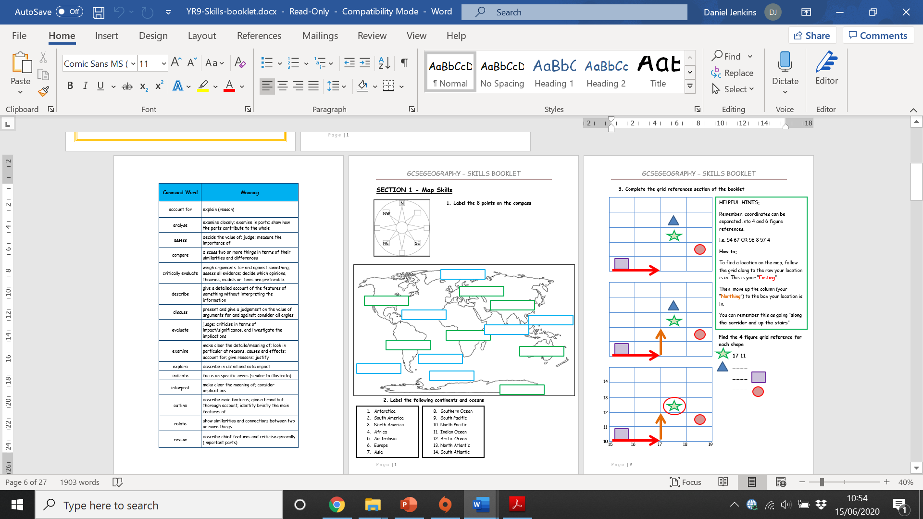
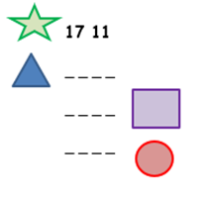
4-figure Grid References
A grid of squares helps the map-reader to locate a place. The vertical lines are called eastings. They are numbered - the numbers increase to the east. The horizontal lines are called northings as the numbers increase in an northerly direction.
Things to remember:
When you give a grid reference, always give the easting first: "Along the corridor and up the stairs".
Four-figure grid references can be used to pinpoint a location to within a square. To find the number of the square:
Start at the left-hand side of the map and go east until you get to the bottom-left-hand corner of the square you want. Write this number down.
Move north until you get to the bottom-left corner of the square you want. Look at the number of this grid line and add it to the two-digit number you already have.
This is your four-figure grid reference.
In this case, the tourist information office is in grid square 4733.
3. Complete the 4-figure references below.

Slide 7
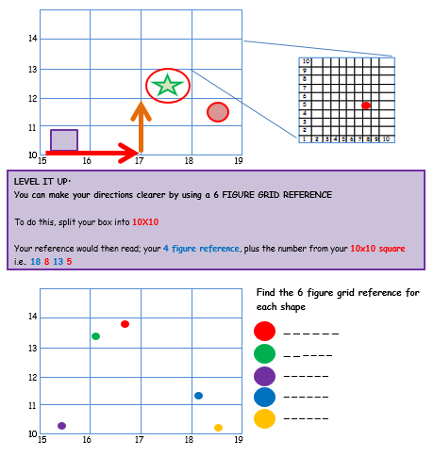
6-figure Grid References
Sometimes it is necessary to be even more accurate. In this case you can imagine that each grid is divided into 100 tiny squares. The distance between one grid line and the next is divided into tenths.
First, find the four-figure grid reference but leave a space after the first two digits.
Estimate or measure how many tenths across the grid square your symbol lies. Write this number after the first two digits.
Next, estimate how many tenths up the grid square your symbol lies. Write this number after the last two digits.
You now have a six-figure grid reference. In this instance, the tourist information office is located at 476334.

Slide 8
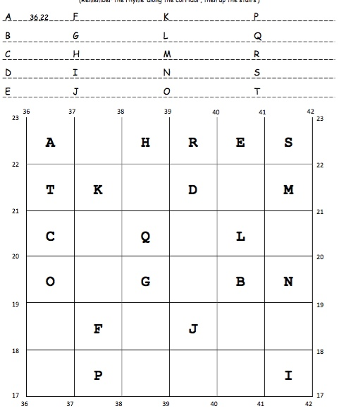


Grid references challenge task:
Fill in the grid square of each letter below, one example is done for you.
CHALLENGE: Find the 6-figure grid reference for the following symbols

Slide 9
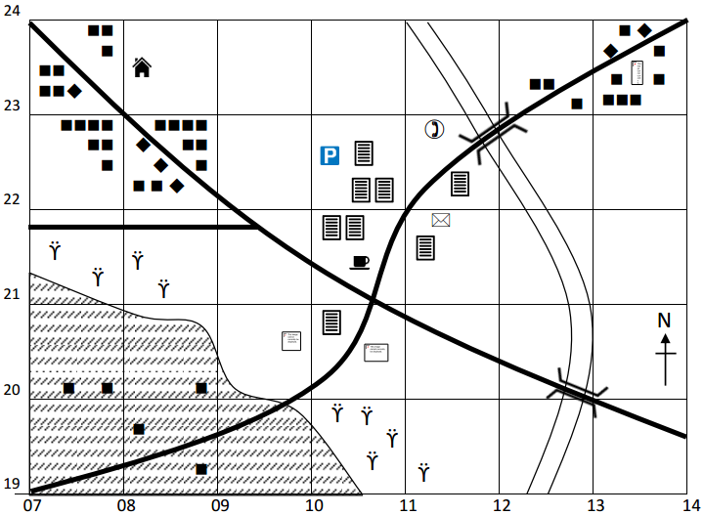
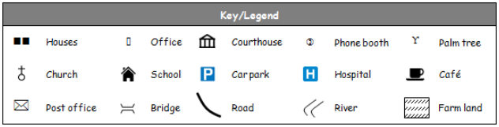
Six Figure Grid References practise task.
Use the map below to answer the questions.
Remember the rhyme ‘along the corridor, then up the stairs’ and to estimate in tenths to give a six figure grid reference.
a) What is the four figure grid reference of the phone booth? __________
b) What is the six figure grid reference of the phone booth? __________
What is the six figure grid reference of the following:
  Hospital __________
  School __________
  Post Office __________
  Church __________
  Café __________
  Courthouse __________
  Car park __________

Slide 10
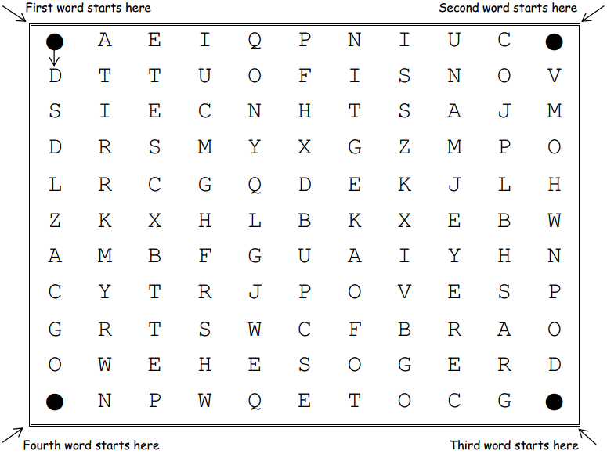
Direction
You need to find the hidden geographical words in the puzzle. In each table directions have been given, follow them to spell out the words. Join the letters together as you follow the directions and complete the tables to find the words. The first arrow has been done for you for the first word. For the fourth word, the word has been given, you need to fill in the directions

Slide 11
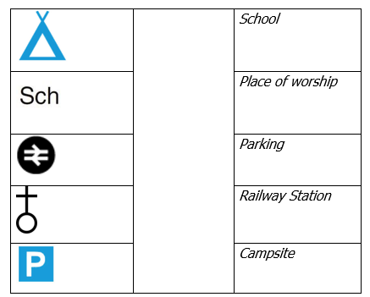
Symbols
Symbols are generally the same on most types of map. For example, buildings or tourist attractions are shown with blue symbols. Different types of roads are shown in different colors - blue for a motorway, red for a main road and yellow or orange for narrower roads. Dotted green lines are usually used to show footpaths.
Task: Match the symbol to the correct description.
Task: Complete the paragraph below by drawing the correct map symbol after the bold word. You must research the actual OS map symbol (using the internet or borrowing an OS map from your teacher.
“I sat by the river where it joined the lake . It was very wet like a marsh . In the distance I could see a main road . There was a Public House with parking available. Behind me there was a lovely orchard . Unfortunately it was going to be knocked down and turned into a large Golf Course . I could also see a railway line . I decided my visit was not over and it was time to return to the coach station , just over the hill by the coniferous woods .”
Task: Now it’s your turn! Make up your own short story like the one above using the box below. You must include at least 10 map symbols in your writing and the correct OS map symbol for each. You can include more than 10 if you like but your story must make sense.

Slide 12
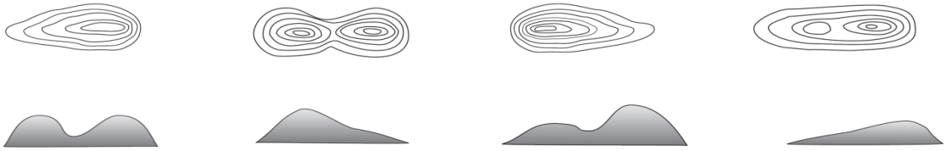
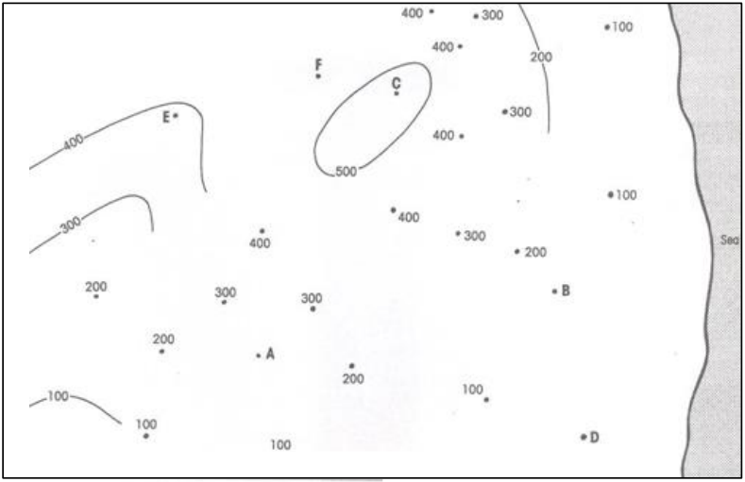

Contour lines
Some maps, especially ones that people use to find their way around the countryside, contain brown contour lines. These are lines that show high and low areas of land.
The contour lines join up areas of the same height, and when they are close together it means the hill or mountain is steep. When they are far apart it means the land is gently sloping, or undulating.
Task: Match the 3D image with the correct contour line image.
Task: Link up the different contour lines and shade the layers with the in line with the key you create below.
Task: What is the height of the land at each of the letters on the map?
  ________ E. _________
  ________ F. _________
  ________
  ________

Slide 13
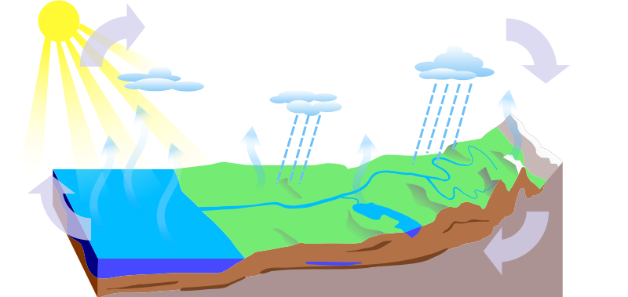
Section 2 – The water cycle
Add the key words to the diagram: condensation precipitation evaporation groundwater flow surface run off transpiration
b) Draw on transpiration.
Explain how the water moves from sea, air and land and back.
Firstly the water starts off in the _________________ it then is transferred to the air by the process of ____________ this is when the sun heats the water and it turns into water vapour. The water vapour then cools and _______________ to form clouds, and falls as ______________. The precipitation then goes back to the sea either by_______________ or ___________________.
Water Cycle key terms.
Complete the list of key terms below.
Precipitation:
Condensation:
Evaporation:
Groundwater flow:
Surface run-off:
Transpiration:

Slide 14
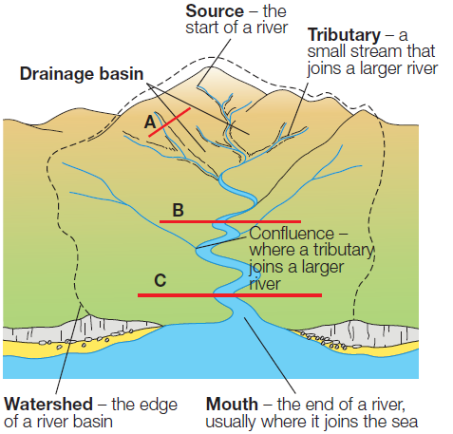
The Drainage basin
Task: Complete the definitions below and label your diagram of a drainage basin.
Key term: | Definition:
Drainage basin
Source
Tributary
Confluence
Watershed
Course
Mouth
CV
CV

Slide 15
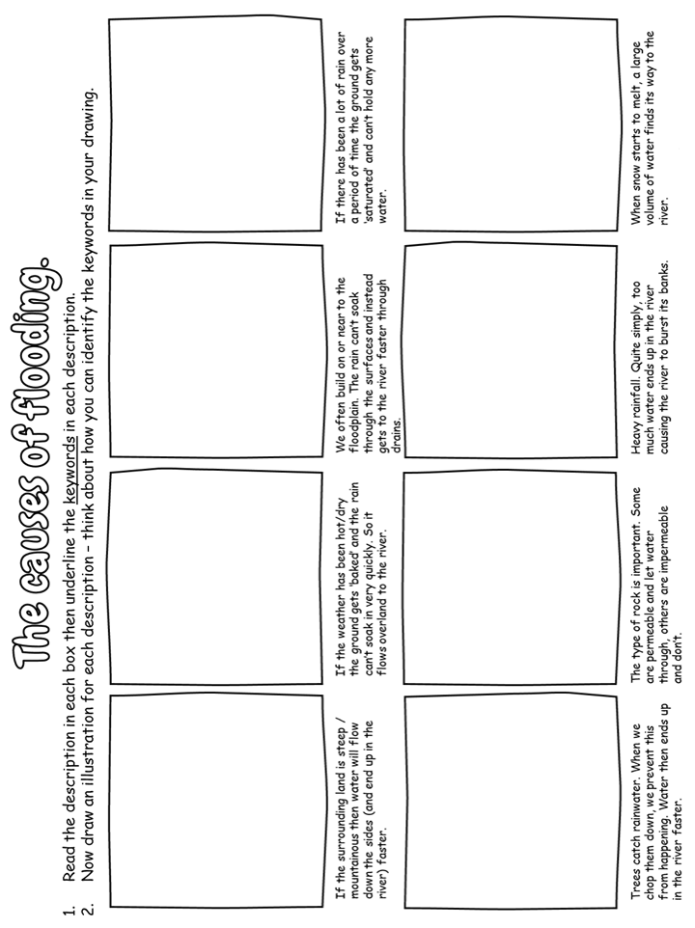
Flooding.
We are now going to look at the causes of flooding. You will need to read the below instructions to create a story board of how flooding occurs.

Slide 16
Cumbria Floods 2015:
Read the news article below and complete the 5 WWW’s of flooding on the next page.
Cumbria floods:
At least one killed as 45,000 homes remain without power
A man in his 70s reportedly died in Cumbrian village of Staveley as thousands of homes are flooded following record levels of rainfall
One person has been found dead and 45,000 properties are without electricity following the flooding that has hit north-west England.
Police said that a body had been found in the water in the river Kent near Kendal after Storm Desmond hit Cumbria. The environment minister, Liz Truss, told MPs that there had been a number of fatalities.
There were reports that a man in his 70s was pulled from a stream close to the river Kent in Staveley. ITV Border said that the man, who died near Kendal, had been trying to retrieve a barrel from the water to prevent flooding further downstream in the village, where 1,376 properties were flooded.
His body was recovered at about 10am on Monday morning by emergency services personnel in Cumbria, who had spent much of Sunday searching for him.
It was the first death following the flooding and the second connected to the storm. In London, a 90-year-old man was believed to have been blown into the side of a moving bus by a gust of wind, near Finchley Central tube station on Saturday.
About 42,000 households in Lancaster, Morecambe and Carnforth in north Lancashire found themselves again with no power on Monday evening, a failure that came hours after Electricity North West said it had restored power in the region. The firm said the power cut was caused by “unforseen damage”.
In Lancaster, 19,000 households were still being supplied by generators that were mobilised overnight. Electricity North West said it was calling for extra generators and engineers from across the country to help restore power.
In Cumbria, 2,657 properties were still without power as night fell, with floodwater restricting access for Electricity North West teams.
Cumbria police estimated that a total of 4,881 homes were flooded across the county, saying that in the “reasonable worst-case scenario” there could be a total of 6,455 homes affected. Thousands of people remained homeless.
David Cameron visited Carlisle, where police estimated between 2,200 and 3,500 homes had been flooded.
Touring one victim’s home, the prime minister promised to look again at the government’s response and said the Environment Agency would assess its response to see what lessons could be learned.

Slide 17
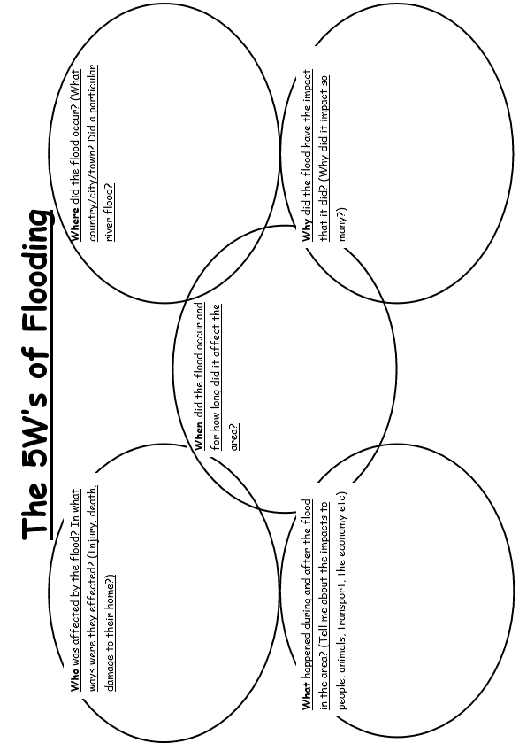

Slide 18
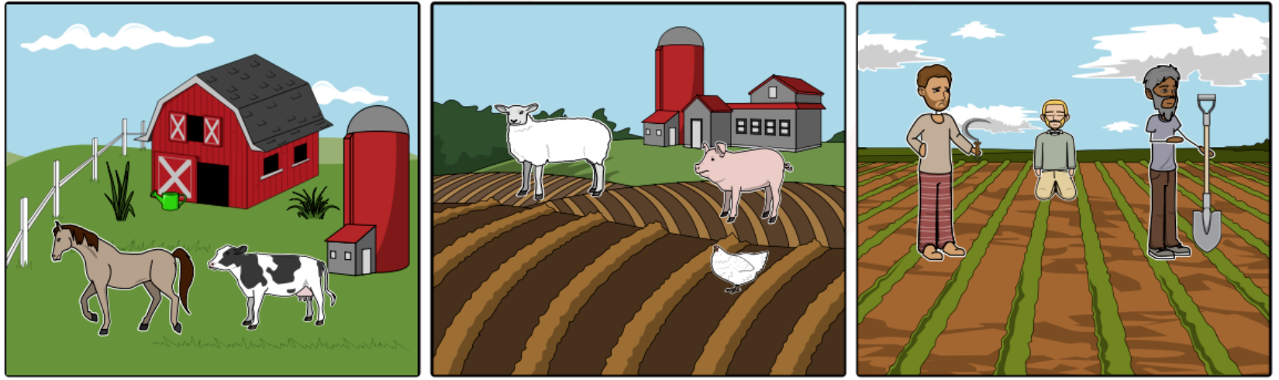
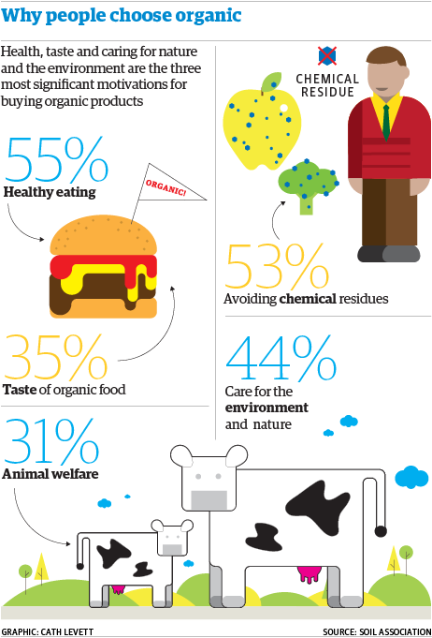
Section 3 – Food and farming
Task: Name the 3 types of farming and describe what they are.
Type of farming: Description: | Type of farming: Description: | Type of farming: Description:
There are two way in which people choose to farm. They are Organic and Non-organic.
Task: Define the following
Organic Farming:
Non-organic farming:
Task: Using the infographic, explain why some people choose to shop organic.

Slide 19
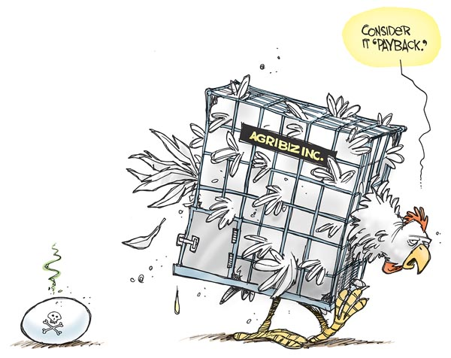
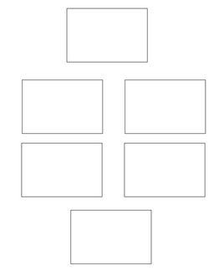
Factory farming
TASK: Factory farming is one of the reasons some people opt for a vegetarian or vegan diet. Look at the cartoon image below and suggest why many people disagree with factory farming.
___________________________________________________________________________________________________________________________________________________
TASK: Below are 6 of the worst impacts created by factory farming. Rank them from most significant to least significant impact.
Factory farming takes over smaller farms. | Factory farming pollutes the land around the farm.
The animals are fed antibiotics. | The animals can sometimes fight and die in their cages.
The animals are kept inside in cramped conditions. | Factory farming focuses more on profits than the conditions of the animals.

Slide 20
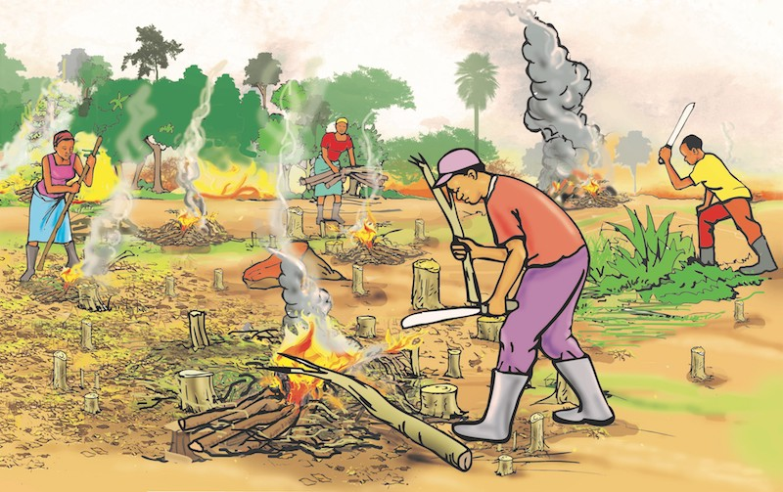
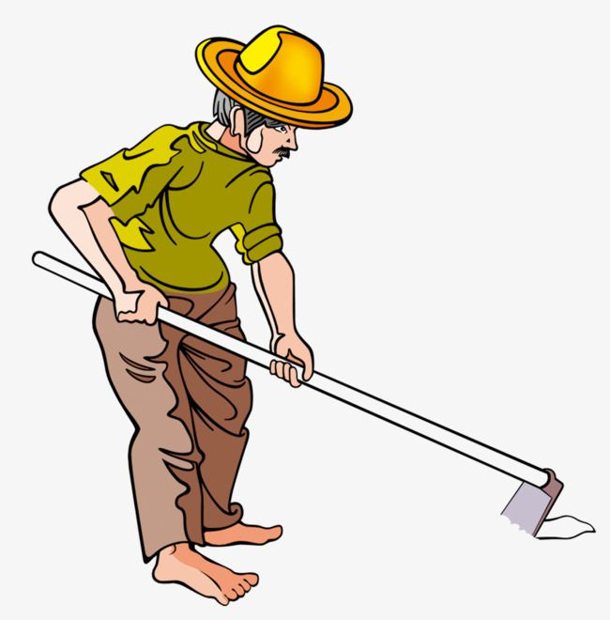
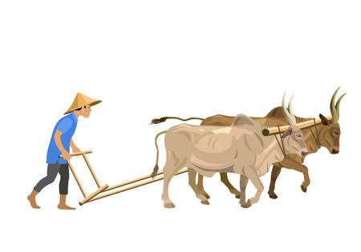
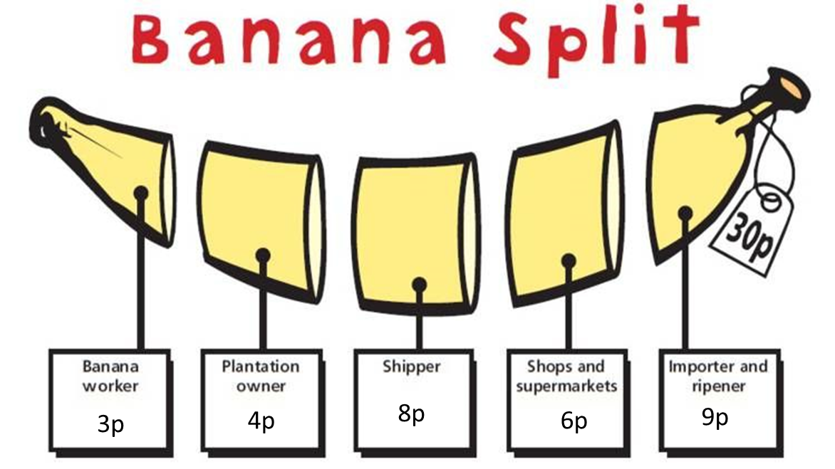
Farming in developing countries.
In developing countries, primary employment types such as farming are dominant. However there are many challenges to farming in some of the poorest places in the world.
Below are some questions you need to research the answers, make sure you use all the sources you are given below.
Q1) What is a developing country?
_______________________________________________________________
_______________________________________________________________
Q2) Look at the images below. What are the different techniques used to farm in developing countries?
_______________________________________________________________
_______________________________________________________________
_______________________________________________________________
_______________________________________________________________
Q3) What is fair trade? And how without it are farmers remaining poor?
_______________________________________
_______________________________________
_______________________________________
_______________________________________
Q3) Most developing counties are in hotter parts of the world. How does a hot dry climate make it difficult to grow food?
_______________________________________________________________
_______________________________________________________________
_______________________________________________________________
_______________________________________________________________
_______________________________________________________________
_______________________________________________________________

Slide 21

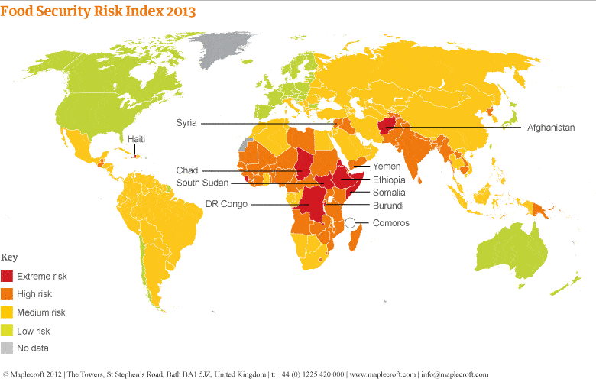
Food availability and security.
Around the world we don’t all have access to the same quantity of quality food. An essential skill as a geographer is to be able to analyse data to explain these global discrepancies. Below we have a choropleth map. This uses colour to represent data. The darker the red the less food a country has, the lighter green the more food they have. Now this information alone it not enough we must write a detailed answer, squeezing as much information out of this map as we can.
TASK: Using the ANALYSE application below, describe the pattern of food availability around the world. Treat each part like a tick box criteria.
AS A WHOLE: What is this data showing? | NUMBERS: what is the numerical data? (use the key) | ANOMALY: What’s different? What’s the exception? | LINK: Knowledge of places and locations? | YOU NEED TO CATERGOSRISE: What reasons are there for some places not having access to food? | SPECIFIC DATA: back it up. Facts, specifics. | EXTRA: What’s missing? What doesn’t it show?
______________________________________________________
______________________________________________________
______________________________________________________
______________________________________________________
______________________________________________________
______________________________________________________
______________________________________________________
______________________________________________________
______________________________________________________

Slide 22
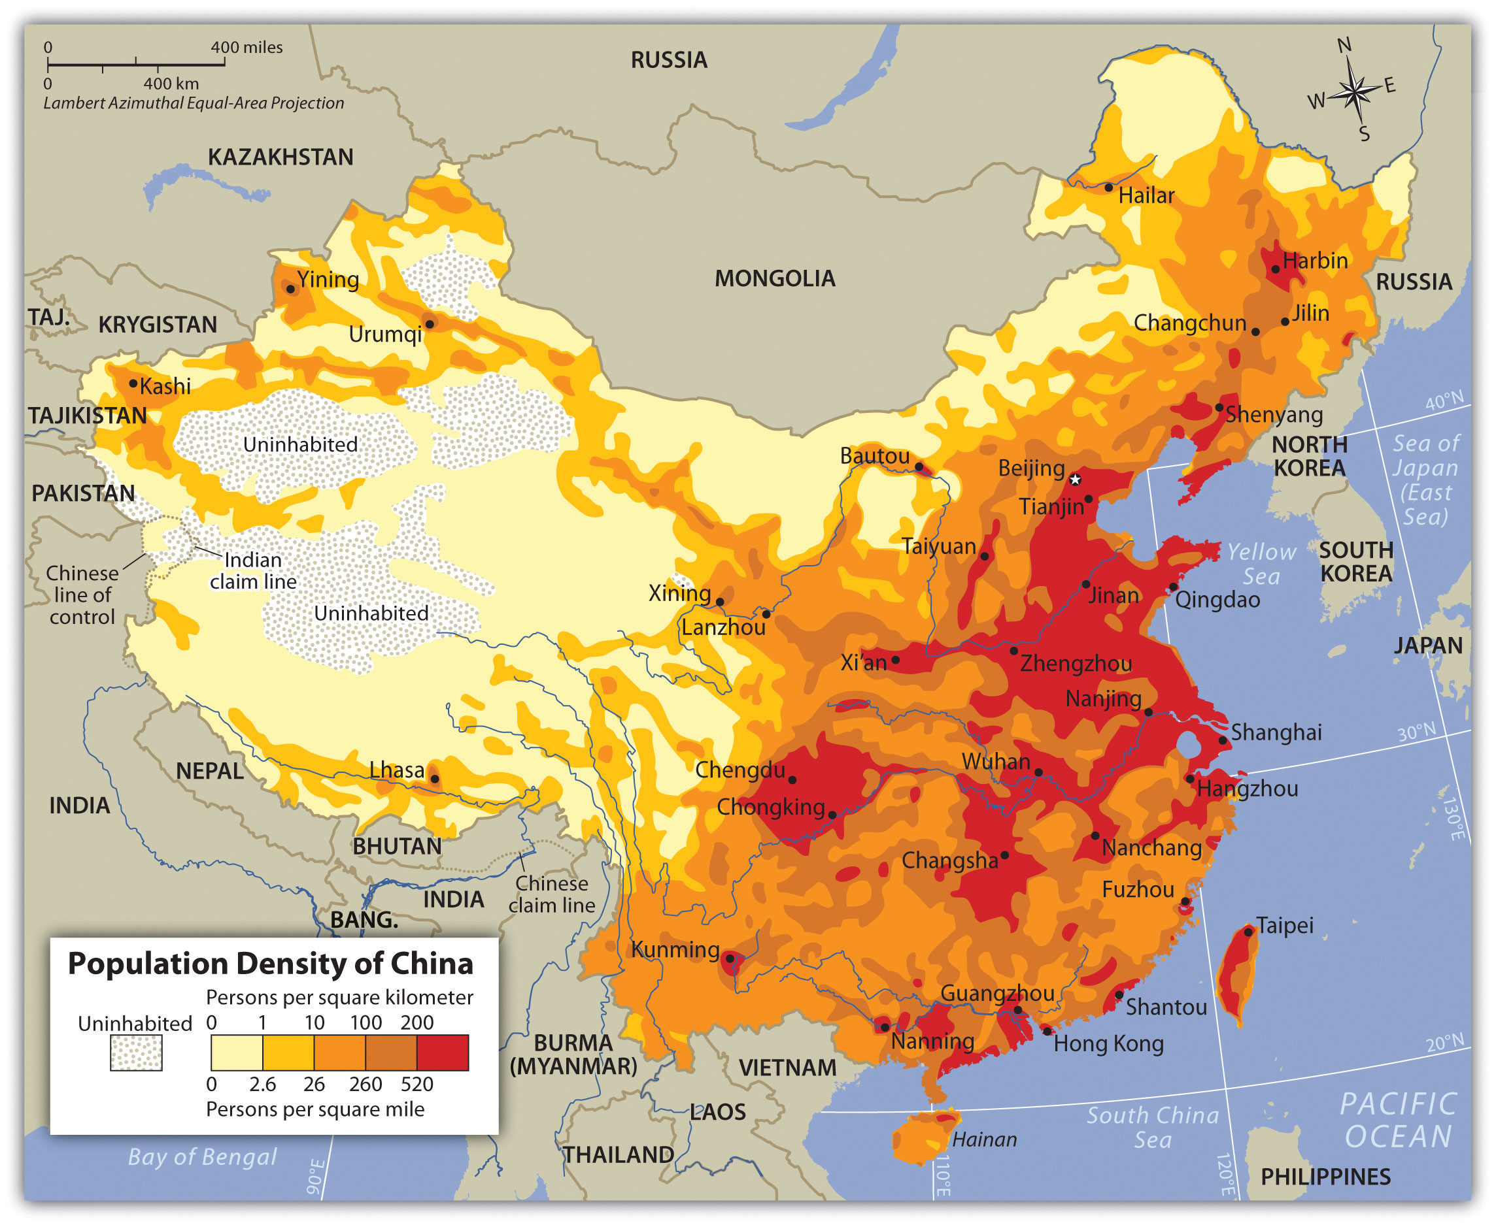
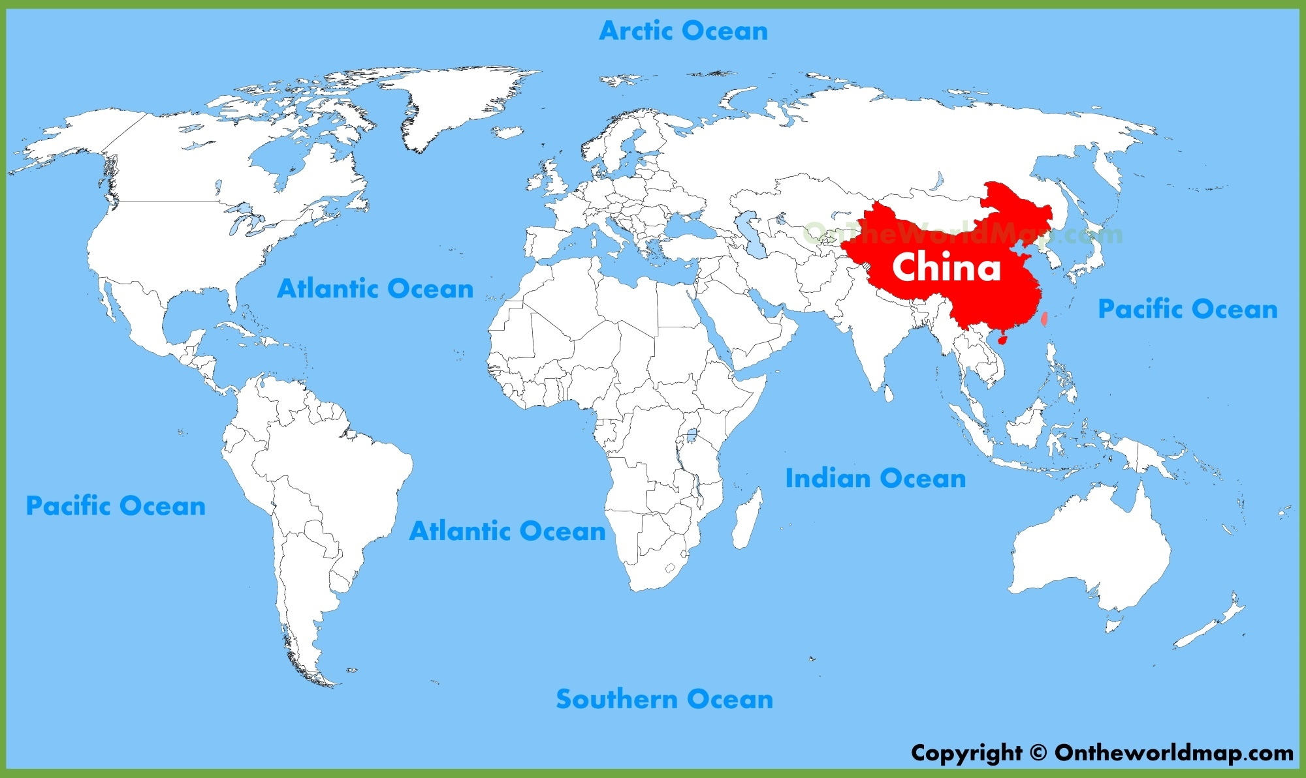
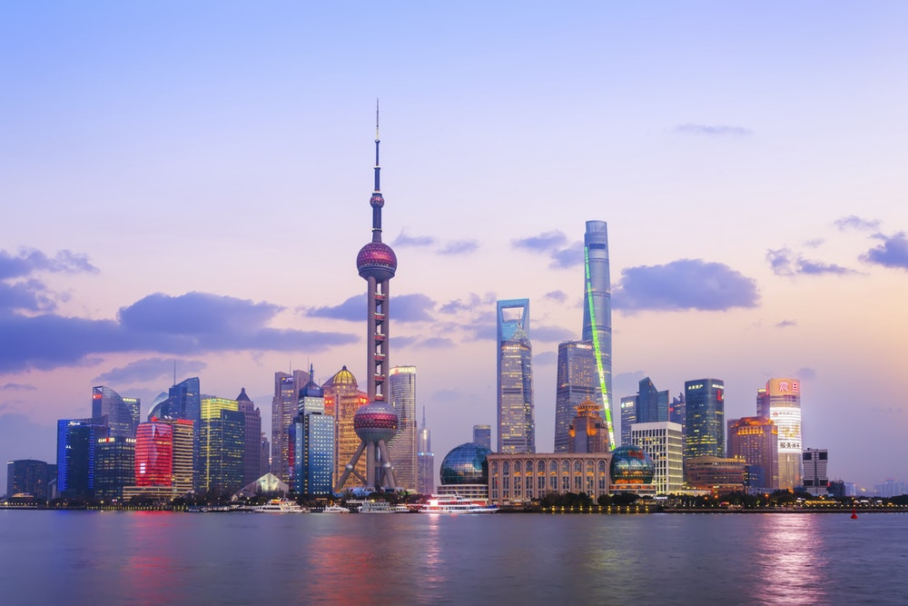
Section 4 – China
Task: Below are 2 maps. Map 1 is showing the population distribution in China (this is a choropleth map). Map 2 is a world map showing the location of China. Use this to answer the below questions.
Q1) Describe where China is located in the world. You must include compass directions, oceans, bordering countries and the continent in your answer.
____________________________________________________________________________________________________________________________________________________________________________________________________________________________________________________________________________
Q2) Describe the population distribution in China. You must include compass points and city names in your answer.
______________________________________________________________________________________________________________________________________
______________________________________________________________________________________________________________________________________
Task: What is a megacity?
__________________________________________________________________________________
What are the 4 most populated cities in China?
__________________________________________________________________________________
_________________________________________

Slide 23
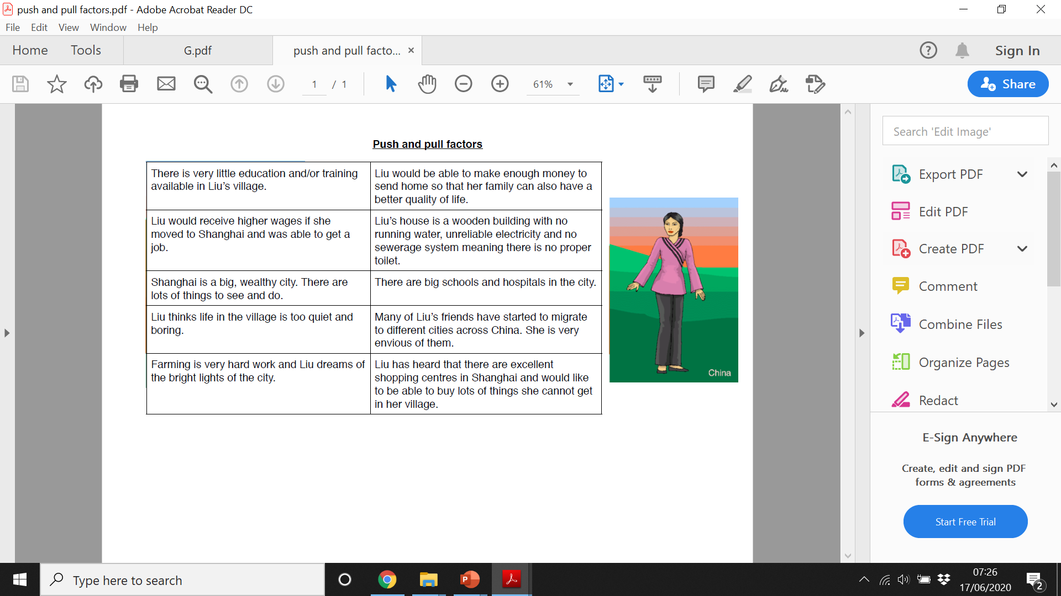

Rural- urban migration in China
Key terms for this section.
Rural-Urban migration - The movement of people from the countryside to cities.
Push factor - The characteristics of a place which make you want to leave
Pull factor - The characteristics of a place which make you want to move there.
Task: Meet Lui, she is considering moving to the city. But why? Below are a series of statements, some of them are push and some are pull factors. Categorise them into each. Make sure you read each of them carefully.
Liu’s diary
Write a diary entry for Lui’s life. Use the information from the last task to help you. You can be as creative as you like. Tell me what she thought living in the city would be like and how she is actually found living there.
__________________________________________________________________________________________________________________________________________________________________________________________________________________________________________________________________________________________________________________________________________________________________________________________________________________________________________________________________________________________________________________________________________________________________________________________________________________

Slide 24
China’s one child policy
China’s One Child policy is a policy that the Chinese government introduced in 1979 to try and solve the problem of overpopulation. Its main purpose was to make sure that China could support its large population with facilities such as healthcare, education, housing, good jobs and most importantly, food. The aim was to reduce poverty and to improve overall quality of life for the people.
Many people supported the one child policy as it helped reduce the rapid overpopulation in China, others were against it. People didn’t like the government making decisions about their family size.
Task: below are some statements. Some arguing reasons for the policy, some are against. You need to categorise them. the people.
The country was severely overpopulated | Starvation was a major problem for the Chinese people | There is now a big gender gap with 60 million more men than women | Female infanticide* has increased since the 1980s *Infanticide: To kill a baby
Parents in China receive the cost of child care and medical expenses for their one child. | Both parents are able to work so they will be financially better off | Abortion rate has gone up as women are pressured if pregnant for a 2nd time | There was not enough shelter for all the population
Babies are being abandoned, particularly baby girls as women are less superior in Chinese society | There will be nobody to look after the elderly | Children get more time with their parents | Couples who break the policy are often forced into sterilisation- human rights infringement
Q) Overall do you think the one child policy was needed, or do you believe that it brought more harm than good?
____________________________________________________________________________________________________________________________________________________________________________________________________________________________________________________________________
___________________________________________________________________________________________________________________________________________________________________________________________________

Slide 25
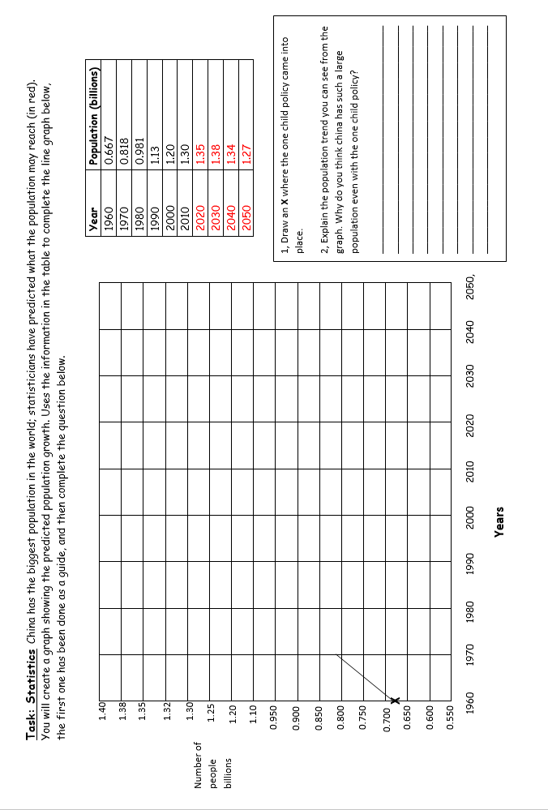

Slide 26
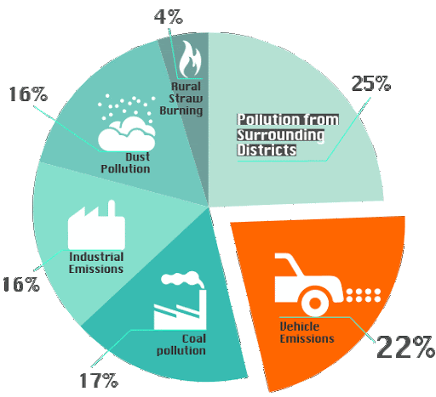
Smog and sustainability
China is the most polluting country in the world as its currently the most rapidly growing economy.
Task: look at the infographic below and use it to answer the questions.
1. What are the 2 main causes of air pollution in China?
__________________________________________________________________________
2. Who is responsible?
____________________________________________________________________________________________________________________________________________________
3. What cause of air pollution has the highest contribution to the pollution levels in Beijing?
_____________________________________-
China is making an effort to reduce its carbon footprint and improve its air quality for its population. One way they are doing this is developing eco-cities. Eco-cities are designed deliberately to be as low carbon as they can or even zero carbon.
You task: Research Dongtan eco city. Using this as inspiration, design your own eco town plan below. You much label your town with all its eco features.

Slide 27
Section 5: tectonics
Journey to the Centre of the Earth
TASK: The Earth’s structure is similar to a scotch egg, it has many layers! Below is a blank diagram of the Earth and its interior structure. Add the following details and produce a detailed, annotated diagram of Earth’s interior.
Name each layer
Depths of each layer
Temperature at each layer
You can add any extra information you find that is interesting on the internet. You may want to add colour to make the diagram stick out visually

Slide 28
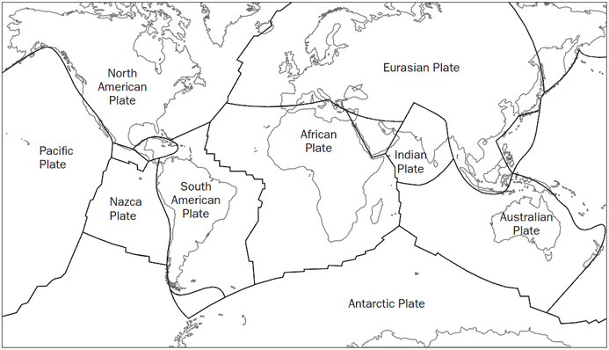
Erupting Tonight!
TASK: Visit the following website: https://volcano.si.edu/gvp_currenteruptions.cfm
Research the location of 15 currently erupting volcanoes and label them on the blank world map below.
TASK: Describe the distribution of the volcanoes currently erupting in the world. Remember to use:
Continent names
Proximity to the coast
Northern or southern hemisphere?
Compass direction
…………………………………..………………………………………………………………………………………………………………………………………………………………………………………………………………………………………………………………………………………………………………………………………………………………………………………………………………………………………………………………………………………………………………………………………………………………………………………………………………………………………………………………………………………………………………………………………………………………………………………………………………………………………………………………………………………………………………………………………………………………………………………………………………………………………………………………………………………………………………………………………………………………………………………………………………………………………………………………………………………………………………………………………………………………………………………………………………………………………………………………………………………………………………………………………………

Slide 29
What are earthquakes?
As plates carry on moving in different directions over long periods of time, friction causes energy to build up. Eventually it becomes so great that the energy is released, which creates a shock wave - an earthquake. If the earthquake is beneath the ocean it can create a huge tidal wave, called a tsunami.
There are thousands of earthquakes across the world each day and some are so small that they can only be detected by specialist equipment. Others can be so intense that they can create lots of damage and destroy towns and cities. The Richter magnitude scale is used to measure the size of earthquakes.
Many earthquakes occur around the Pacific Ocean. People who live there, in countries such as Japan, are used to earthquakes happening and build earthquake-resistant buildings that sway with the shock waves rather than fall down.
Although there are earthquakes in the UK, they are rare and so small that most people do not feel them.
Q1: What are earthquakes measured on ………………………………………………………………………………………………………
Q2: What causes earthquakes? …………………………………………………………………………………………………………………....
……………………………………………………………………………………………………………………………………………………………
Q3: Give one location that experiences earthquakes regularly?
……………………………………………………………………………………………………………………………………………………………
TASK; See the table of impacts below. Categorise these into Social, Economic and Environmental impacts.
Social = people Environmental = natural world.
Economic = money
People may be killed or injured. Homes may be destroyed. Transport and communication links may be disrupted. | Water pipes may burst and water supplies may be contaminated. | Disease may spread. People may have to be re-housed, sometimes in refugee camps.
The built landscape may be destroyed. Fires can spread due to gas pipe explosions. Fires can damage areas of woodland. | Shops and businesses may be destroyed. Looting may take place. | The cost of rebuilding settlements is high.
In poorer nations, the emergency services will not be able to cope with the effects. | Landslides may occur. Tsunamis may cause flooding in coastal areas. | The earthquake aftershock could cause further unexpected damage.

Slide 30
Volcano film review.
Write a review of the film or documentary for The Howard Geographical Magazine. You should aim to write a minimum of 200 words. Use the space below. You can either write in the box, write it on lined paper then stick it in or type it on word and stick it in.
Watch a film or documentary about one of the famous eruptions in history. Choose from:
Pompeii
Mount Pinatubo
Montserrat
Mount St. Helens

