Slide 1
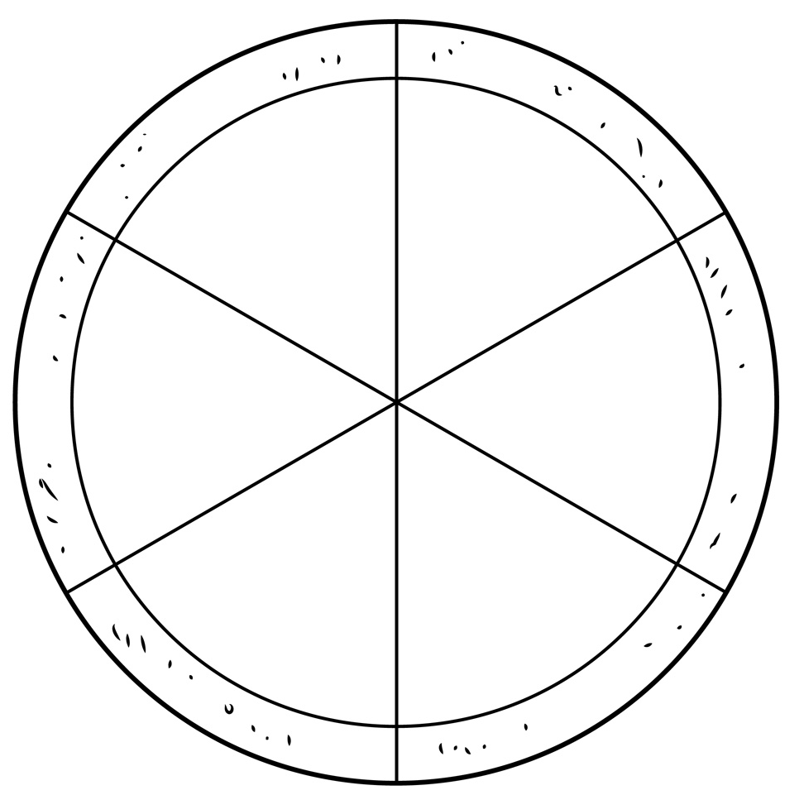
World at Risk
Droughts
Earthquakes
Revision PIZZA!
Activity: Organise your information toppings into the correct slice of pizza. Each slice represents a risk previously studied.
Climate Change
Volcanoes
Aim High
Can you organise each information topping within each slice of pizza? Organise into causes, effects and responses.
Diseases
Hurricanes
Causes |  | Effects |  | Responses

Slide 2
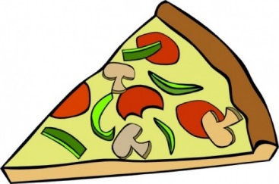
World at Risk
Revision Pizza Toppings
Caused when two plates become locked. This will cause pressure to build up and be released as seismic waves.
Treatment using drugs can improve recovery. Also vaccinations can prevent people becoming infected.
Viruses can spread through person to person contact or a bite from an inserts such as mosquitoes carrying the malaria virus.
The vibrations can cause buildings to collapse and damage roads. Deaths and injury can be commonly high.
Search teams aim to recover people from the rubble. Aid is given out to reduce impacts.
Buildings can be made safer.
Little rainfall can lead to death through dehydration and hunger. Crop failure and conflicts can also occur.
Causes when one plate subducts beneath another. Magma rises through the crust to erupts on the surface as lava or ash.
Burning less fossil fuels and saving energy will reduce harmful gas emissions. Using more renewable energy.
The burning of fossil fuels has increased the amount of greenhouse gases in the atmosphere.
Warmer temperatures are causing more droughts and storms to occur more frequently. Melting ice caps are causing flooding.
Eruptions can cause lava, gas and ash to destroy houses. This can cause death, injury and homelessness.
Most eruptions can be predicted. Responses involve evacuations and aid to people affected by the eruption.
They form over warm ocean and are hundreds of miles across. They create high winds that can be over 150mph.
Reducing the effects of climate change can prevent raising temperatures. Provide food and water to affected areas.
Below average rainfall over a long period of time. Conditions are dry with little to no water sources.
The high winds can damage houses and create high waves that flood towns. People can die or become homeless.
Disease mostly effects the poor. Often being ill means you can’t work. In many cases, death can occur.
These large storms can be forecasted before arrival. If warnings are too late, aid is provided to people in need.

