Slide 1
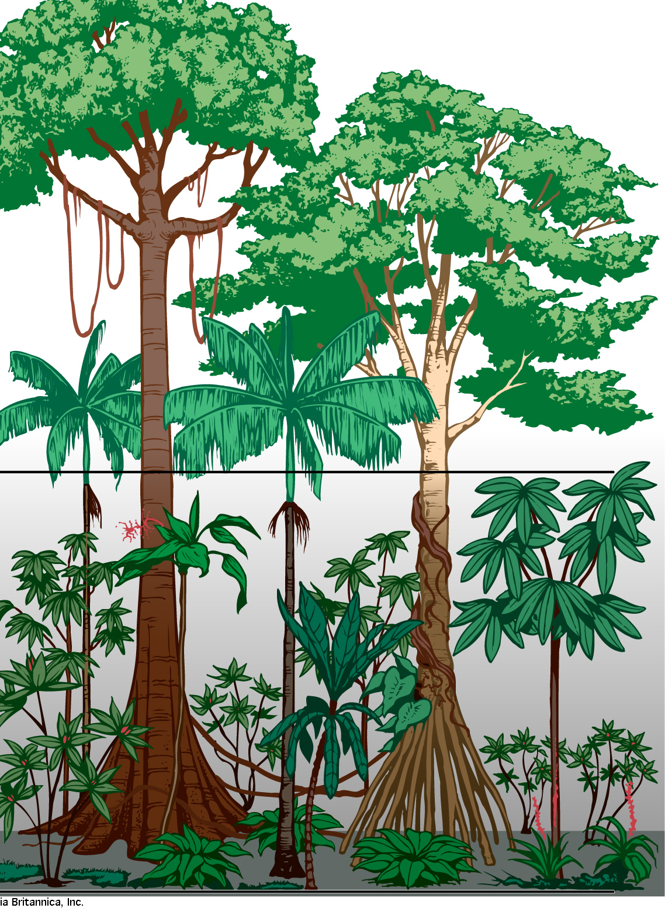
1.
2.
Find and define 3 key words from the past few lessons. (Look at your work to find these!)
Name four causes of deforestation. Hint: why do we cut down the trees?
5.
1.
1.
3.
Finish the
mind map to
show the different ways we can manage the rainforest.
2.
2.
Label the different layers of the rainforest
3.
3.
4.
How can rainforest be managed sustainably?
Tropical Rainforests
10 minutes per section
4.
Complete the
flow chart to show the
different impacts of deforestation
Impacts of Deforestation
Global
Local

