Slide 1
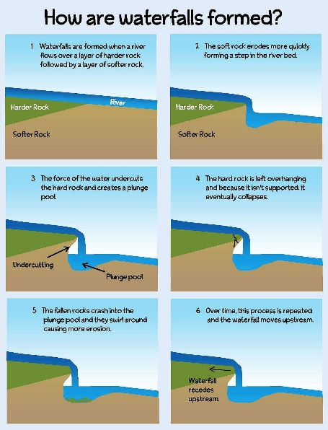
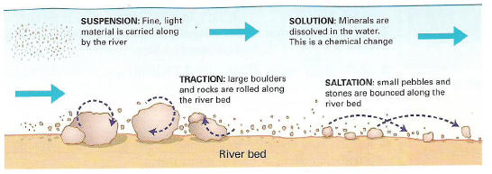
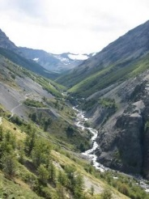
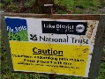
What makes landscapes distinctive?
Landscapes are made of different features and landforms. Some of these features combine to make it special or distinctive. Within this unit there are examples of upland and lowland landscapes as well as river and coastal landscapes.
Physical landscapes are often affected by human activity. Some are positive… Visitors to the countryside spend money which boosts the local economy. Some are negative… Too many visitors can affect the local environment and community.
A honeypot site is an area that experiences excessive visitor numbers e.g. Bowness, Lake District
Positives in Bowness Increase in rural income from tourists Investment in tourism has allowed communities to diversify a farming economy | Negatives in Bowness Congestion Local shops often changed into souvenir stores House prices rise due to second homes Footpath erosion Litter
Processes that create river landscapes
Erosion; Abrasion – material carried by the river hitting the bed and banks Hydraulic action – the force of the river water hitting the bed and banks (for example it compresses the air in gaps in the soil causing it to be washed away Attrition – stones carried by the river colliding with each other Solution slightly acidic river water dissolving chalk and limestone rocks
Transportation
Process for waterfall caused by differential erosion As the river crosses onto soft rock it is eroded
Meanders
Distinctive Landscapes
Landform process and change
Drainage basins of the UK
Theme 1
Landscapes & Processes
Can distinctive landscapes be managed?
Many of these distinctive landscapes are Areas of Outstanding Natural Beauty (AONB) or National Parks. Visitors to these areas must be managed in order to reduce their impact on the landscape.
Examples of Management techniques in the Lake District National Park Designated footpaths protect sensitive areas Detailed visitor information boards educate tourists about importance of conserving the environment Clearly marked car parks reduce people parking on grass verges Investment in public transport reduces car use Strict control of planning and building ensures new developments are restricted. Footpaths are maintained using hard wearing materials like stone. Often volunteers help with the maintenance
Deposition (dropping of material) This may happen because There has been a lack of rainfall so there is less river water On the inside of a meander because the velocity is lower At the mouth of the river where it flows into the sea
River Landforms
V Shaped Valley
Waterfalls and Plunge Pools – can be formed by differential erosion (where rocks change structure between hard and soft rock) or glacial erosion (caused by glaciers)
Drainage basins – this is the area of land drained by a river and its tributaries. As water moves through it flows from one store to the next.
Interception – when rainfall does not reach the ground e.g. it may be blocked by trees Infiltration – the movement of water into soil Throughflow – the flow of water through the soil Overland flow – the flow of water over the ground Transpiration – water given off by plants
Stream has to go around interlocking spurs
Vertical erosion makes steep valley sides – this creates V shape
Weathering processes such as freeze thaw break down soil and rock on valley sides

Slide 2
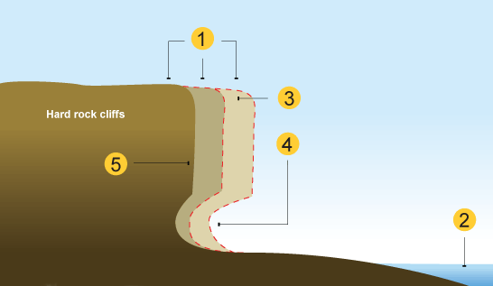
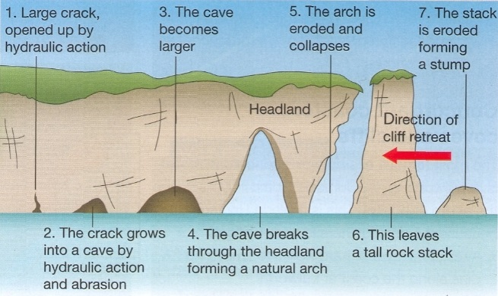
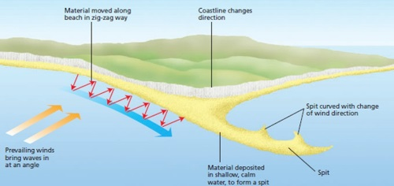
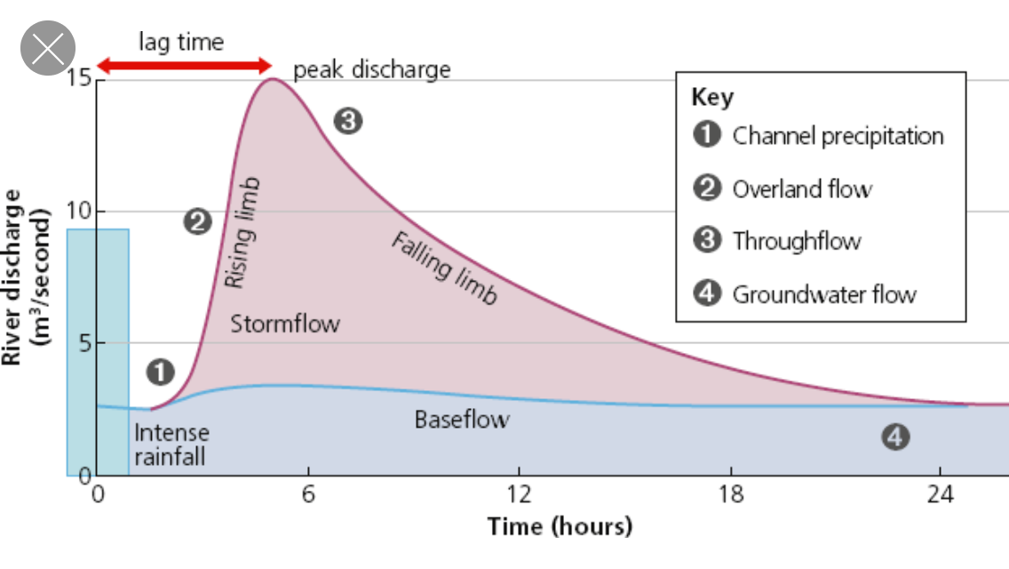
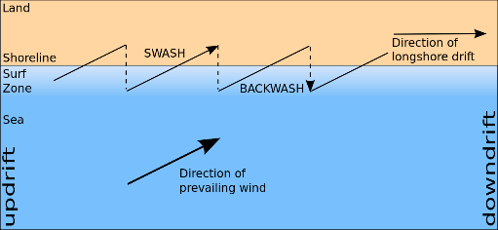
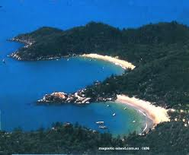
Why do rivers flood?
Climate – Seasonal rainfall – continuous rainfall causes the ground to become saturated, leading to more overland flow A storm event – when sudden heavy rain causes a sudden rise in river levels
Vegetation – Different types of vegetation intercept different amounts of rainfall. This influences how fast water moves to the river Removal of vegetation – if trees are removed from a drainage basin the water reaches the channel quicker
Geology – Impermeable rocks do not allow water to pass through, so there is more overland flow and the water reaches the river faster Porous rocks let water through and so slow the rate it gets to the river
Urbanisation The expansion of towns and cities has meant more land is covered with impermeable surfaces like concrete.
Responses to flooding
Hard engineering involve constructing large scale, expensive defence to control process. For example building a dam or river engineering. They are often the most effective.
Soft engineering – involves working with the environment rather than destroying it. They are often smaller scale and cheaper. For example, afforestation. They are normally less effective
Land use zoning – Planning how the land is used so less valuable land closer to the river is used for things like farmland. Housing and key services are often put on higher ground. However, it is not always easy because some buildings were built years ago near to the river.
Why do rivers flood?
Wave cut platforms | Hydraulic action and abrasion erode the cliff creating a wave cut notch (4) The material above is left unsupported and eventually collapses (3) and retreats (1) A flat platform is left behind.
Arches and Stacks
Spits
Coasts
Erosional processes that affect the cliffs are; Hydraulic action the force of the water crashing into rocks Abrasion – the waves hurl sand and pebbles against the cliff, which wears the land away Solution – salt water dissolves the rock
Erosional processes that affect the beach; Abrasion – see above Attrition – pebbles are rolled back and forth. They collide with each other and make each other smaller
Coastal Transportation – longshore drift
Hydrographs show how a river will react to a storm. It shows the total rainfall (shown as a bar graph) and the amount of river water (discharge) shown as the line graph.
The lag time is the time between peak rainfall and peak discharge (the time taken for the water to reach the river). Impermeable surfaces will create a shorter lag time because the water moves to the river faster.
Example of a river flood – River Severn 2007
Causes – heavy rainfall throughout June. This meant the ground was saturated. Heavy storm on July 19th. Recent development create impermeable surfaces
Effects – 3 dead. M5 motorway shut. Crops ruined. Long term – schools and businesses closed for long time
Factors that affect the rate of erosion
Geology – the type of rock and the way it was created affect the rate of erosion e.g. Concordant coastlines are when the rocks are created parallel to the sea so erosion along the coast is even. Discordant coasts are when the material is formed at right angles to the sea so erosion varies along the coast.
Climate – this affects both coastal and river erosion. Coasts – the prevailing wind affects the angle the waves hit the sea, and so affects the landforms created. Rivers- the more rainfall the more water in a river and so the more erosion there will be.
Human activity Deliberate activities like management techniques reduce erosion e.g. gabions (cages filled with rocks) are used to absorb the power of the water.
Coastal Landforms
Headland and Bays Headland is an area of land the sticks out into the sea. It is made of harder rock which is more resistant to erosion. A bay, made of less resistant rock is formed between headlands.

