Slide 1


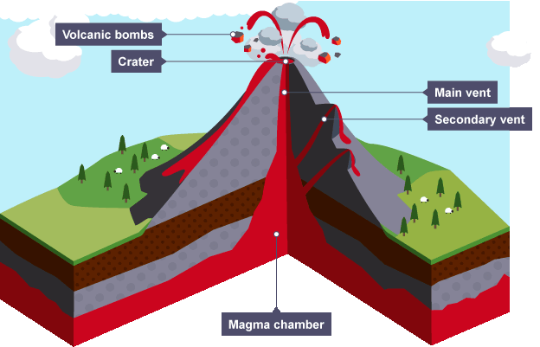
The earth is made up of a series of layers. The outer layer is called the crust. This, itself, is made of 2 different types Continental Crust (which is on average 35km thick) Oceanic Crust (which is much thinner, between 6-8km)
The crust and the upper mantle, which makes up the hard part of the earths surface is known as the lithosphere. The lithosphere is split into tectonic plates.
A constructive margin is where two areas of crust move away from each other (powered by the convection currents underneath). As they move apart volcanoes are formed. | A destructive margin is where an area of oceanic plate meets continental plate. The oceanic plate is forced underneath and is drawn back into the mantle (this is know as subduction). As it is forced down pressure often builds and leads to energy being quickly released (an earthquake)
A conservative boundary is when two plates move past each other. As with the destructive boundary, the pressure between the plates often builds and is suddenly released (leading to an earthquake)
Volcanic hotspots are small areas of the earths crust that has an unusually high amount of volcanic activity. Although some do occur on plate boundaries many do not (eg. The Hawaiian Islands) One suggestion about the way they form is;
Intense radioactivity in the Earths interior creates a large column of magma (known as a magma plume) The plume rises, melting and pushing through the crust above. The plume lies in a fixed position under the plate – as the plate move over it, a series of new volcanoes are created along the plate.
Large Scale features of a volcanic landscape;
Shield Volcano (e.g. Mauna Loa, Hawaii). Found at constructive plate margins and hotspots A circular volcano with gently sloping sides |  | A Caldera – is a large volcanic crater which could be several km in diameter. It is formed when a magma chamber is emptied and the roof collapses or through a massive explosive eruption.
Stratovolcano (e.g. Mount Merapi, Indonesia) Found at destructive plate margins Cone shaped with steep sides |  | A lava tube is a hollow tunnel forms when the outside of a lava flow cools and solidifies and the liquid passing through it drains away.
Tectonic plates and not stationary and move around relative to each other. High temperatures in the earths core cause convection current and a plume of hot magma rises through the mantle. The oceanic plate is forced upwards by this and is torn apart – forming a mid ocean ridge. Oceanic crust crashes into continental crust, is forced downwards and creates an ocean trench. The magma eventually cools near the surface and sinks back down to the mantle.
Plate movement (as shown above) cause earthquakes and volcanoes. The point where two plates meet is called a plate boundary or margin; Destructive plate margins are where plates move together. Constructive plate margins are where plates move apart.
Theme 3
Tectonic Landscapes and Hazards
Tectonic Processes and Landforms
Vulnerability and Hazard Reduction
Tectonic processes (such as those above) result in the formation of a series of distinctive landscapes. These include;
Large-scale feature | How it is formed | Location | Example
Ocean Trench | Where subduction takes place | Destructive plate margin | Mariana trench – Pacific Ocean
Fold Mountains | Continental crust is crushed and folded upwards | Destructive | Andes Mountains – South America
Explosive volcanoes | As the oceanic plate sinks it melts and finds its way to the surface | Destructive | Mount Merapi - Indonesia
New Crust | Where 2 ocean plates move apart, the area between is filled with magma | Constructive | Mid-Atlantic
Ocean Ridge | As lava cools a ridge is formed under the sea | Constructive | Mid-Atlantic Ridge
Submarine volcanoes & volcanic Islands | Submarine volcanoes (below the surface) sometimes rise above the surface to create volcanic islands | Constructive | Surtsey, Iceland
Rift valley | Where 2 continental plates pull apart | Constructive | Thingvelir, Iceland
Measuring the strength of volcanic eruptions is difficult since they produce different materials and last for different amounts of time. In 1982, the volcanic exclusivity index (VEI) was devised. It measures the amount of pyroclastic material produced, the height of the eruption and the duration. The strength of magnitude of an earthquake was traditionally measured with the Richter scale. The moment magnitude scale (MMS) has now replaced it. It measures the distance moved by the fault and multiplies it by the force needed to move it. Both the Richter scale and MMS are logarithmic – which means each number of the scale is 10 times greater than the one before it.

Slide 2





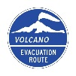
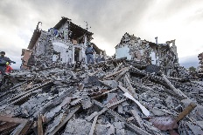
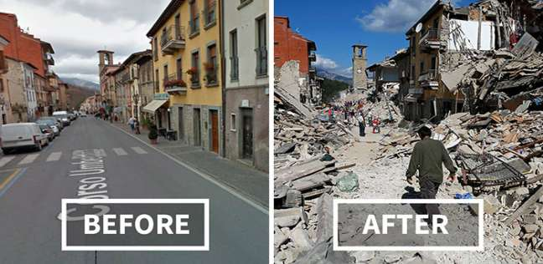
Vulnerability and Hazard reduction
Tectonic processes may cause a range of hazard; earthquakes, tsunamis and volcanic eruptions. The immediate consequences of an event are the primary effects. For example, people injured inside a building that collapses. Secondary effects result from primary ones. For example, the collapsed building will make people homeless. Secondary effects may last for years after the event.
Many physical factors will increase the vulnerability to volcanic hazards;
Hazard | Characteristics | Scale
Lava flow | Molten rock flows down the side of a volcano. | Local – may travel several km and threaten towns and villages in their path
Lahars | Volcanic mudflows consisting of a mixture of ash and water from rain, melted snow and ice. | Local – may travel several km and threaten towns and villages in their path.
Ash clouds | Ash thrown into the atmosphere shuts out the sun and when it settles covers the ground, buildings, crops and power lines. | Large – may reach 10-15km high and spread over thousands of kms.
Pyroclastic flow | Burning clouds of gas and ash with temperatures up to 1000ºC travelling at speeds of up to 200km/h | Local – may travel several kms.
Human factors that increase vulnerability;
Wealth; poor people are less able to withstand disasters and have less money or insurance policies to recover.
Education; where populations are able to read and write, written messages can be used to spread warning or give advice about how to cope.
Governments; can support education and awareness and can pass building regulations
Age; children and the elderly are more vulnerable
Health; healthy people are more able to cope.
Population density; the more people living in the area the more people that will be affected
Time of the day; e.g. earthquakes in rush hours have a more devastating effect
Emergency services; richer countries have well trained and well resourced response teams
Example of a Volcanic Eruption – Mount Merapi, Indonesia Located on the island of Java. It is in a densely populated area. It erupted in 2010.
Impacts | Social | Economic & Environmental
Primary | Ash clouds caused breathing problems 352 deaths 570 injured 320,000 evacuated | Ash destroyed crops and 1900 farm animals died Ash caused flights to be cancelled Ash and rock deposited in River Gendol
Secondary | 20km danger zone declared around volcano Thousands lived in emergency shelters for weeks Not enough toilets or drinking water | 1300 ha of farmland abandoned Food prices rose – many couldn’t afford food. Fewer tourists and lost money from agriculture ($700 million total loss)
How can we reduce the risk?
Earthquakes are difficult to predict but there are some monitoring techniques; Laser beams can detect plate movement A seismometer is used to pick up vibrations in the earths crust. These can lead up to an earthquake Levels of radon gas can increase suddenly before an earthquake.
Monitoring Techniques used to predict volcanic eruptions include; Remote sensing. Satellites monitor gas emissions and thermal imaging can work out the temperature within the volcano. Seismometers can pick up movements in the earth which sometimes occur before an eruption. Visual signs. Often the appearance of a volcano changes before an eruption.
Tsunami warning system; Following the 1960 Chilean earthquake the Pacific countries decided to set up the Pacific Tsunami Warning System (PTWS). This is a network of seismometers and ocean buoys that detect earthquakes and ocean movements. Warnings are then given to local centres, which warn local people using the TV, radio, text messages and sirens.
Example of an Earthquake; Italy 2016 Measured 6.2 on the Richter scale and struck in central Italy at 03:36 am on 24th August 2016. Caused by collision of African and Eurasian plates. The focus was at a shallow depth of 6km
Impacts | Social | Economic & Environmental
Primary | 295 deaths and 400 injured It hit during summer holiday season so population of the area was higher due to tourists | $11bn was the cost of repairs A 4.6 magnitude earthquake followed 2 days later causing more damage
Secondary | Over 500 aftershocks left 2500 homeless In Amatrice village over half the buildings were destroyed | Tourist industry will take years to recover Italian press criticised government as historic towns do not have anti earthquake building laws
Many physical factors will increase the vulnerability to earhquakes;
Earthquake hazards include; Bridges and buildings collapse and underground pipes break as a result of the movement of the earth Soil liquefaction causes a buildings foundations to be damaged. Landslides bury people and buildings Tsunamis can cause severe damage and death Things that make areas more vulnerable include; Magnitude: the stronger the hazard the more severe the impacts Duration: the longer a hazard lasts the more severe the impact Predictability: hazards that hit with no warning have a larger impact Regularity: hazards that happen more regularly have larger impacts as communities don’t have chance to recover.
Hazard Mapping highlights areas affected by or vulnerable to earthquakes, volcanoes and tsunamis It allows local authorities to; Reduce access to hazardous areas Control developments at risk of tectonic hazards Invest in techniques to monitor the hazards in these areas
New building technology can also reduce the impact of earthquakes. Often they are built to absorb the energy and withstand the earths movement.
Emergency planning; An exclusion zone can be set up around a volcano Lava flows can be diverted Emergency services can be trained and given the equipment needed. People put together emergency kits which include first aid items, blankets etc.
Example of a hazard map – Soufriere Hills Volcano, Montserrat
This hazard map divides the island into 6 zones. Access is restricted depending on how active the volcano is; Zone V – out of bounds to all except scientists Zones A-C and E; residents on high alert, have rapid means of exit & own hard hats and dust masks The northern zone – lower risk, suitable for residential and commercial development E&W (maritime exclusion zone – exist because pyroclastic flow travels out to sea.

