Slide 1
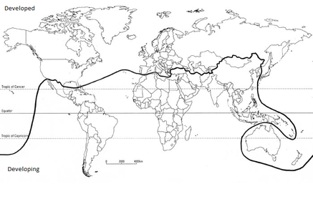
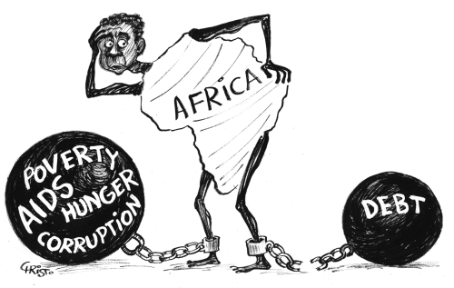
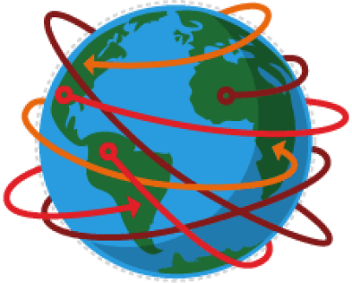
Development is the process that improves wealth or quality of life.
Economic Development = increased employment and rising income Social development = rising life expectancy, better education, healthcare, clean water and housing Political development = a stable government and greater freedom of speech
A development gap exists between richer and poorer countries. The “Brandt” line splits the world into more developed “global north” countries and less developed “global south” countries. The line dividing them is known as the “north-south divide” or the Brandt line.
However, the Brandt line is a bit too simplistic. In reality there is a “development continuum”. This is a sliding scale from super rich countries to the very poor. The World Bank splits countries into 4 categories based on their Gross National Income (GNI); HICs with GNI of $12,736 or above Upper Middle Countries with GNI between $4126 and $12735 Lower middle countries with GNI of $1046 to $4125 LICs with GNI of $1045 or less
Causes and consequences of Uneven Development
Trade involves buying goods from other countries (imports) and selling them (exports) HICs generally EXPORT valuable goods such as electronics, cars and financial products. They import cheaper primary products like tea, sugar and coffee. LICS do the opposite. This means they earn little and remain in poverty
The prices of these products go up and down but HICs tend to have the biggest influence over them. LICs lose out when the price drops, but have little control over it. Increasing this trade changing the balance of imports/exports is essential for LICs to develop. Some HICs impose tariffs (import costs) and quotas (a limit to the amount of imports).
Newly Industrialised Countries (NICs) have developed as world trade and globalisation have occurred. NICs have;
Rapid economic growth based on exports Rapid urbanisation Stable governments and strong leaders | Large amount of investment by foreign multinational corporations (MNCs)
MNCs have grown as a result of globalisation. Often they are free to decide where they locate many aspects of their company. The headquarters if usually found in a global city such as London. However, other parts of the company can be located around the world. Factors like, government incentives, location of raw materials, labour costs and reduced costs for buildings and land make a difference. MNCs can bring advantages and disadvantages to a country;
Advantages | Disadvantages
Investment provides new jobs and skills for locals | Profits are often sent back to the HIC where the MNC is based
The multiplier effect spreads wealth through the area | MNCs can often leave quickly if they find it cheaper elsewhere
 | They often cause wide scale pollution
Example of a Multinational Coorporation – Nike Manufactures sports equipment in 41 countries and sells it in over 700 stores worldwide Production is outsourced to countries such as India, China, Vietnam Global sales in 201 were $28 billion
Theme 6
Measuring development
Causes and Consequences of uneven development
Water resources
Regional Economic Development
Development & Resource Issues
Example of a Low Income Country – Malawi In Malawi 84% of people are employed in agriculture and it accounts for 85% of exports. The Tea industry employs 50,000 seasonal works. At the end of the picking season they are out of work. Tea is grown on 44 estates owned by 11 international companies. There are also 10,000 locally owned small tea farms 90% of the tea grown is exported to the UK and South Africa. Malawis imports are dominated by fuels products (30% of total imports) The economy is heavily dependant on aid from the IMF and World Bank.
Example of an NIC – India Reasons for rapid economic growth Investment in education provided highly skilled workforce Investment by MNC’s such as IKEA and Samsung created manufacturing jobs It has a stable government It has the 2nd largest English speaking workforce in the world It has low wages (compared to main rivals Mexico and China) It has a young workforce Many organisations (Such as the World Trade Organisation WTO) promote free trade between countries.
Nike in Vietnam – a Newly Industrialised Country (NIC) Nike locates in Vietnam because; Wages are low Factories and land is cheap Low tax rates Low energy bills Few laws and restrictions protecting labour force Impacts of Nike in Vietnam;
Advantages | Disadvantages
Created 40,00 jobs and improved local skills | Investment could be transferred to other countries quickly, so people would have no jobs
Pays higher wages than most local companies | Nike has large demand for energy and water
Helped Attract more MNCs | Factories have reputation for abuse of workers
Contributes to tax which helped pay for schools etc | The company might undermine national culture
In order to compare development between countries there are a number of measures . Economic measures include Gross domestic product (GDP) the total value of all goods and services produced within a country Gross National Income (GNI) per capita; average wage per person Employment structure; the type of work people do (for example, primary, secondary, tertiary) Poverty; the % of the population that earn less than $1.90 a day
However, these methods do not always give the most accurate picture of a countries development. Limitations include; They only measure wealth and not social factors (like life expectancy) They do not show inequality in country (gap between rich and poor) They do not show the cost of living (ie. the amount that can be bought with the average wage)
Example of an LIC – Malawi Located in south central Africa and has population of 16.8m 90% of population earns less than $2 a day Most live in remote rural areas. Few roads or other means of transport Soil infertile, few use fertilisers. Families are large and 2.8m suffer from malnutrition Education is poor. 30% of children do not attend primary school (even though its free) Illness or injury is common (12% of population affected by AIDS) It is landlocked so finds trade with other countries difficult Main export is low value primary goods such as tea and sugar. Imports are high value oil and machinery.
Trade has changed massively over recent decades. Trading internationally is now the norm. Globalisation is the name of the process that leads to the flow of goods, services and ideas around the world. Increased globalisation has lead to countries being more interconnected. Globalisation has occurred because; Technology (such as the internet) has improved Communication has improved (e.g. satellites) Transport improvement (such as cheaper air transport) The removal of tariffs and growth of trading blocs.
As a result of globalisation the TOURIST industry has grown rapidly. It now accounts for 1 in 11 jobs worldwide. It is increasingly becoming important for low and middle income countries. Rapid growth is due to; Early retirement and longer life expectancy mean older people can spend time travelling People earn more so have more disposable income Modern aircraft make is cheaper and quicker The internet allows people to research destinations

Slide 2
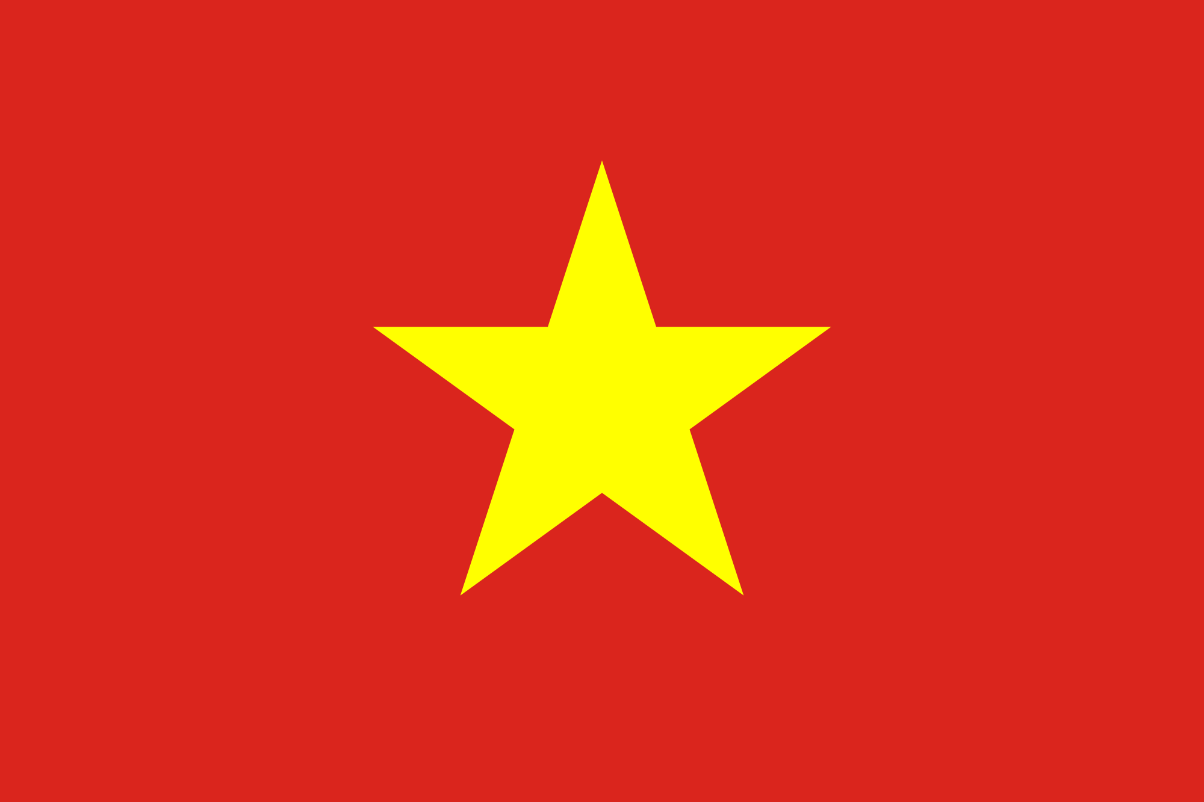
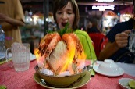
As mass tourism has become more popular issues have arisen Modern developments in tourism include Enclave tourism – where tourists pay one price and get all travel, accommodation, food and drink in one place. Cruise holidays – cruise ships sell all inclusive packages
Due to the tourists spending their money with a multinational holiday company and not local businesses it means many locals fo not benefit from the tourists. The profits are LEAKED back to the MNCs that own the airline, hotels and cruise ships. Those that do benefit from tourists, such as fruit and souvenir sellers, often work in the informal sector.
Despite these issues many countries still see the tourist industry as a route to development. It increases the tertiary sectors, but the positive multiplier can also mean more primary and secondary employment. For example, a hotel will buy food from local farmers, who may spend their money on fertilisers or clothing. The impacts of tourism include;
Benefits | Costs
Generates employment. | Jobs are often low paid and temporary
Brings foreign exchange | Local culture is destroyed
Wealth can be invested in service such as health and education | Fragile ecosystems, for example sand dunes, are destroyed
New facilities provided for tourists can be used by locals | Increased pollution from road and air traffic
Using aid to develop. Aid is the transfer of resources from a richer country to a poorer country. Different types of aid include: Bilateral aid – between two countries Multilateral aid – money donated by richer countries via organisations such as the UN Short term emergency aid – immediate relief following a natural disaster Long term development aid – a sustained programme of aid which aims to improve the standard of living Debt abolition – when richer countries cancel debt owed by poorer countries Aid from non-governmental organisations (NGO’s): given through charities such as Oxfam.
For | Against
Emergency aid saves lives and reduces misery | Aid can increase dependency on the donor country
Development aid can lead to long term improvements and increase standards of living | Profits from the large projects can go to multinationals and donor countries
Assistance in developing natural resources benefits global economy | Aid doesn’t always reach the people who need it and can be kept by corrupt officials
Aid for industrial development creates jobs and aid for agriculture increases food supply | Aid can be spent on prestige projects in urban areas rather than in the areas of real need
Provision of medical training and supplies improves health | Aid can be used as a weapon to exert political pressure on the receiving country
Water Resources and management
The global consumption of water is rising. This is because; Population is rising Economic development. The more developed a nation the larger the use of water. Increased need by agriculture (e.g. mechanised sprinklers) Industrial growth. As more MNCs invest in NICs and LICs the more they will demand water. Consumerism – in richer countries we use things like dishwashers and washing machines.
How can we manage the supply of water?
Build damns and reservoirs to store water Water supply schemes to “trade” water between countries. Use of groundwater Water conservation e.g. dual flush toilets.
India is a country that is over extracting its groundwater (the water table is 4m lower than in 2000) Reasons for this; Some states like Gujarat have a long dry season Surface stores (like reservoirs) are often polluted Cheap electricity has encouraged farmers to dig deeper wells Solutions; The government can build more dams (this is an example of top down development) Farmers could be encouraged to conserve water e.g. rainwater harvesting (this is bottom up development)
Example of tourism in an NIC: Vietnam 6 million tourists visited Vietnam in 2016. The increase was due to: Improved transportation – especially air travel Relaxed visa rules and greater private ownership Better image: Vietnam war finished over 40 years ago Attractive foreign exchange rates make Vietnam a cheap place to visit Unique tourist attractions such as: Cu Chi Tunnels – used in the war Temples - of various religions Cuisine – a large variety of foods Halong Bay – famous limestone karsts Lango Co beach – beautiful spit and lagoon feature Wildlife – diverse
Example of aid helping to reduce inequality in an LIC: Malawi Most people in Malawi are subsistence farmers. The area in Middle Shire is affected by soil erosion during the rainy season. Reasons for this include: Rising population meaning deforestation due to increase need for firewood and land to grow food. Tobacco is the main cash crop; falling prices means more needs to be grown to generate the same return.
The Community Vitalization and Afforestation in the Middle Shire (COVAMS) project. This is a ten year project funded by the Japanese government aimed at reducing soil erosion by: Education on the causes Training farmers to plough hillsides following contours, slowing runoff. Building rock, wood and bamboo barriers across streams to slow the water flow Building terraces to reduce runoff Supplying fast growing tree species to speed up afforestation. These types of projects kick start the development process.
Fair trade – a guaranteed and fair price for a product The benefits include: Minimum wages and safe working conditions Restrictions on child labour Protection of the environment Improved schools and healthcare Fair trade products include tea, coffee and chocolate. They often cost more than non-fair trade products.
Fair trade: Ghana’s cocoa trade Ghana is a country in west Africa. It trades in gold, oil and cocoa. 2.5 million framers grow cocoa as their main crop 90% is grown in smallholdings Most cocoa is sold for export 75% is exported to the EU where it is made into chocolate in Germany, Belgium and the UK Production fluctuates depending on the weather, pests and disease The average income for a cocoa farmer is £160 a year. Fluctuating prices for commodities such as cocoa, tea and sugar makes it harder for farmers in Ghana to ear a fair wage.
India is a good example of a country were development varies between regions; e.g. Bihar is less developed (80% of population live in rural areas, education is poor, birth rate is high, farms and small and many work in this sector) Compared to well developed Maharashtra (3 of the largest cities in the country, centre for banking and insurance, lots of MNCs)
The UK also has regional differences. We have a north/south divide. In the north life expectancy is lower, average wage is lower, house prices are lower – many young people migrate to south for jobs.
A solution would be HS2. This high speed rail would encourage hi-tech companies to locate further north and therefore through jobs, or a positive multiplier bring development to the north.
Advantages | Disadvantages
Employs 25,000 directly and 500,000 indirectly, bring $16.4 billion to the economy in 2015 | Many tourist development are partly owned by foreign companies. Some profits leak overseas.
Tourism is encouraging new skills and improving language skills | Jobs are seasonal, many people lose their jobs during the wet season
New services such as transport can be used by tourists and locals | The growth of sex tourism is becoming an issue beyond young girls and boys
New national parks are being created to protect wildlife | The arrival of tourists can cause a decline in local cultures, for example loss of language

